Slide 1
  Congratulations on taking the first step in educating your chapter about ASDA Advocacy.
  This is a template presentation that you can edit based on your chapter’s advocacy needs.
  Some of the information on subsequent slides is strictly for you as a leader. It serves as a guide to help prepare you for leading your chapter’s advocacy efforts.
  You can expand on some of the slides in this presentation for lunch & learns at your chapter.
  We hope you find this resource useful and enjoy engaging with #ASDAadvocacy
DELETE THIS SLIDE FROM YOUR PRESENTATION

Slide 2


Advocacy 101:
Energizing advocacy
Notes:
USE THIS SLIDE AS YOUR OPENING SCREEN.
Note the Molar Bear in upper right corner. This is ASDA’s official advocacy mascot!

Slide 3

What is advocacy?
Advocacy: the act or process of supporting a cause
  Using social media to educate people about a cause
  Educating the community on issues
Lobbying: to conduct activities aimed at influencing public officials to support or oppose a specific piece of legislation
  Visiting members of Congress
  Writing letters to your members of Congress
  Organizing a town hall meeting
Notes:
Advocacy: talking to peers, friends, etc. to educate them on the issues. Share truthful, fact-based information.
Lobbying: Efforts to influence those with decision-making powers to turn bills into law.

Slide 4

Advocacy misconceptions
“I’m not a politician. I don’t have a strong political background or extensive knowledge of the issues.”
“It doesn’t make a difference. Legislators don’t listen to students or young voters.”
“Advocacy and partisan politics are two sides of the same coin.”
“Advocacy takes too much time.”
Notes:
The goal isn’t to become a “politician.” It’s to understand how these issues affect you as a dental student. We are here to learn more about the issues!
Legislators can’t possibly know about every single issue their constituents are concerned about. They actually need people like dental students to educate them on the issues. It’s nice to hear from young people and how the issues affect them directly, like student loan debt.
ASDA does not affiliate with any specific political party. We support legislation that addresses our advocacy priorities, including those for dentists/dental students and patients we serve. We say we advocate for “the Tooth Party” – neither Democrat nor Republican party; just issues that affect the dental profession.
You can invest as much or little time as you have! Sending an ASDA Action letter takes 30 seconds. Alternatively, you could educate yourself a little deeper by attending a lunch and learn (like this), or dive even deeper and attend Lobby Day to fully engage with advocacy and the lobbying process.

Slide 5

ASDA Advocacy
  Keeps students informed on issues impacting the dental profession.
  Represents dental student interests and provides opportunities to champion our rights as future dentists.
  Supports our patients by advocating for the protection and advancement of their welfare within our profession.
Notes:
3 goals of ASDA advocacy:
Keep students informed – this is achieved through advocacy webinars and ASDA’s e-publication Advocacy Brief. Advocacy Brief shares updates on the state and federal level about issues that affect dental students, like licensure reform, midlevel providers, student debt, etc.
Provides opportunities to champion our rights and get involved– ASDA Action – send letters directly to lawmakers. Lobby Day students have the unique opportunity of actually meeting face-to-face with lawmakers and discuss issues important to dental students
Supports patients – support specific legislation to alleviate barriers to care, protect patients. For example: the LABEL Opioids Act of 2021: To amend the Controlled Substances Act to require dispensers of certain opioids and opiates to affix on the container or package thereof a clear, concise warning that the opioid or opiate can cause dependence, addiction, and overdose, and for other purposes.

Slide 6
The Issues
Notes:
FOR FACILITATOR:
The following slides will give basic overview of some of the issues ASDA advocates for. Feel free to expand on any of the issues and dive deeper.
For all of ASDA’s issues and legislative priorities, visit https://www.asdanet.org/index/get-involved/advocate/issues-and-legislative-priorities

Slide 7
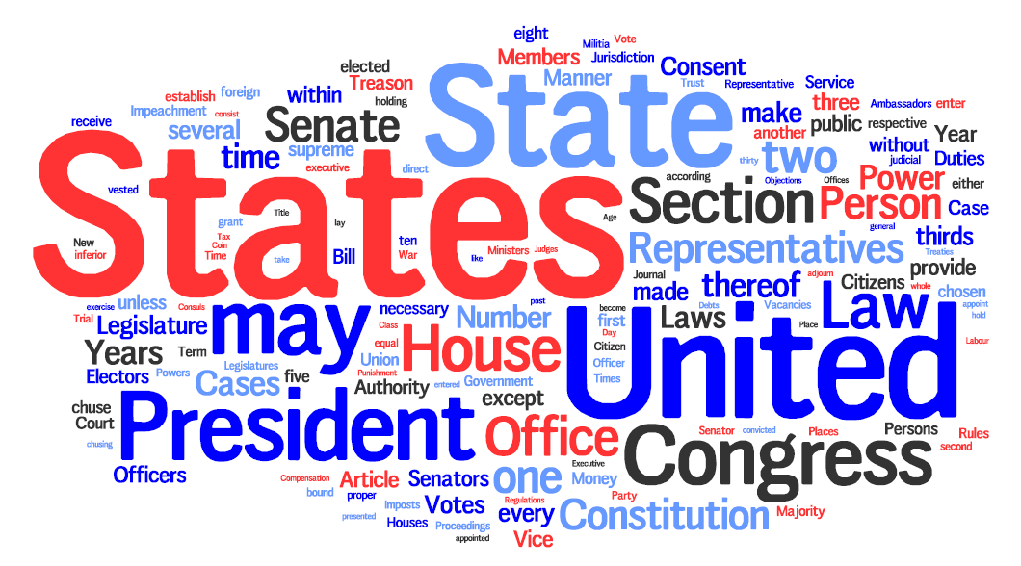
The Issues
Licensure reform
Midlevel providers
Barriers to care
Dental student debt
Opioids
Vaccinations

Slide 8

Licensure Reform: ASDA’s Ideal Exam
Licensure reform
Midlevel providers
Barriers to care
Dental student debt
Opioids
Vaccinations
ASDA believes an ideal licensure exam:
  Does not use human subjects in a live clinical testing scenario
  Is psychometrically valid and reliable in its assessment
  Is reflective of the scope of current dental practice
  Is universally accepted
Notes:
Licensure can be a complex topic. ASDA’s L-1 policy outlines these ideals.
Does not use human subject - perhaps the most controversial issue with the current dental licensure exam process is that it is performed on a live human subject. Testing on a human opens poses various ethical, reliability and validity concerns. These high-stakes, one-shot testing scenarios on human subjects must end.
Psychometrically valid and reliable – Humans are unique. Administering an exam on human subjects means the student taking the test is experiencing a different test than other students.
The current exam is not reflective of the broad set of skills a dentist is required to be knowledgeable of when practicing
The current exam is state-driven, meaning each state determines the requirements for receiving a license in that state. Additionally, most dental licenses are only valid in the state in which you became licensed. For example: receiving your license in Washington does not necessarily mean you can practice dentistry in Michigan as well.

Slide 9

Licensure Reform: ASDA’s Recommendation
Licensure reform
Midlevel providers
Barriers to care
Dental student debt
Opioids
Vaccinations
ASDA believes demonstration of both kinesthetic and clinical decision-making competence is necessary to obtain initial dental licensure. ASDA believes this should be demonstrated through:
Manikin-based kinesthetic assessment and
A non-patient based Objective Structured Clinical Examination (OSCE).
Notes:
An examination with these two components would ensure competency in a greater breadth and depth of skills than any currently implemented or proposed method of initial clinical licensure. The OSCE has been shown to have psychometric validity.

Slide 10
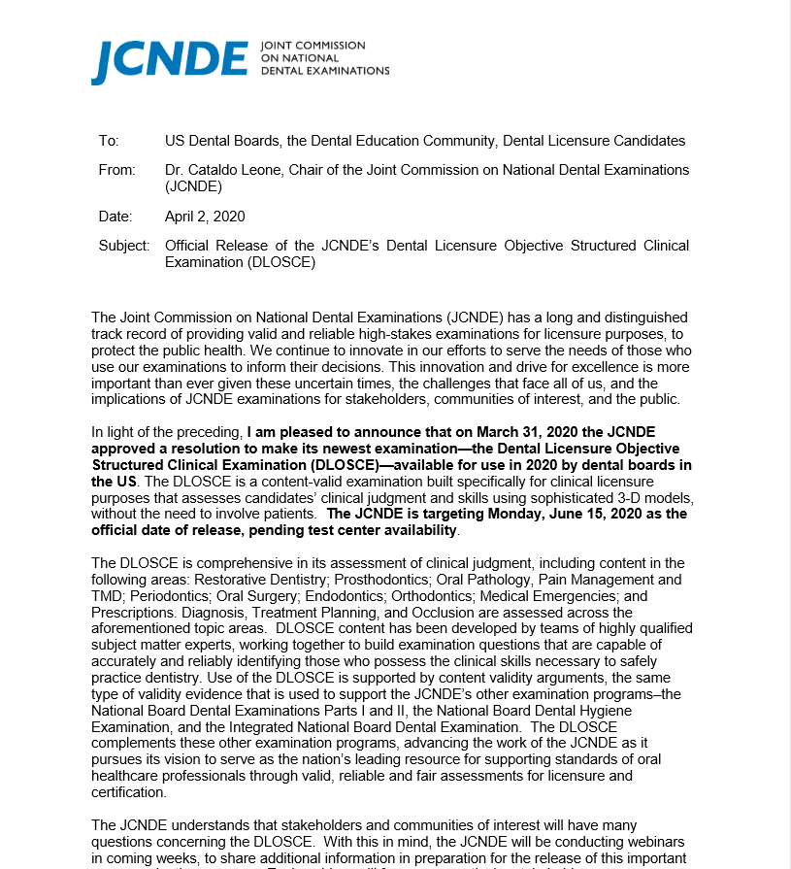
Licensure Reform: Available alternatives
Licensure reform
Midlevel providers
Barriers to care
Dental student debt
Opioids
Vaccinations
  Changes in the licensure process during COVID-19 pandemic:
    All five regional testing agencies (CITA, CDCA, CRDTS, WREB, SRTA) released manikin-based assessments
    The ADA’s DLOSCE (Dental Licensure Objective Structured Clinical Examination) was released a year ahead of schedule
    Graduating students could apply for a temporary or provisional license
Notes:
After decades of advocacy, ASDA saw rapid momentum for licensure reform during the COVID-19 pandemic. Students successfully proved to state boards and testing agencies that a live human subject is not necessary to demonstrate competency.
On a state-by-state basis, any combination of the bullets above were accepted for 2020 and 2021

Slide 11
Licensure Reform: 2023 Update
Licensure reform
Midlevel providers
Barriers to care
Dental student debt
Opioids
Vaccinations
  Prior to 2020, only 10 states accepted non-patient based alternative exams.
  As of April 2023, 47 states (plus DC) permanently allow their initial dental licensure examination to be completed on a manikin.
  6 states accept the DLOSCE, the Dental Licensure Objective Structured Clinical Examination.
Notes:
ASDA is committed to ensuring every state permanently allows dental students to complete their licensure exam on a manikin. Today, 47 states have made permanent changes to allow this.

Slide 12
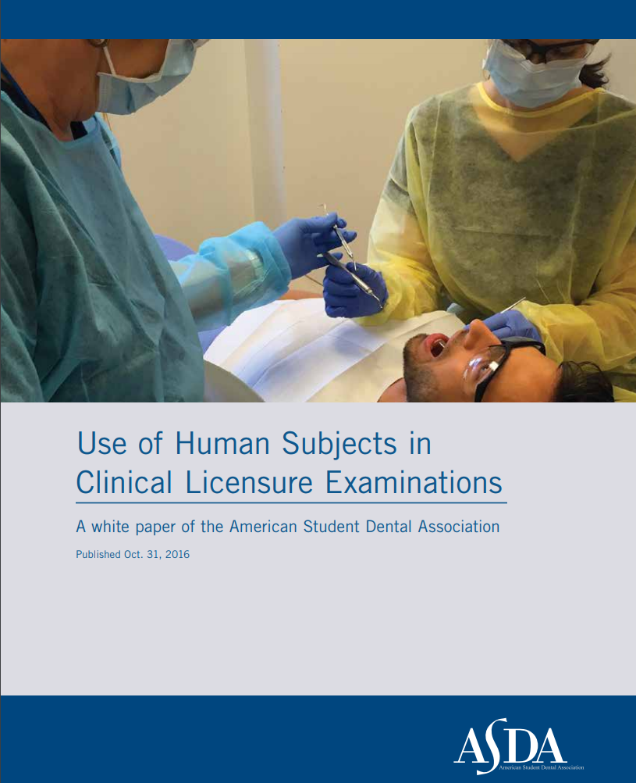
Licensure Reform: ASDA’s Efforts
Licensure reform
Midlevel providers
Barriers to care
Dental student debt
Opioids
Vaccinations
  ASDA’s 2016 licensure reform white paper addresses concerns with validity, reliability and ethics
  Licensure Task Force
  Developed resources like the Licensure 101 flyer and PowerPoint presentation
Notes:
In 2016, ASDA published a white paper detailing the major shortfalls of the current licensure examination process. (Access the white paper: http://www.asdanet.org/uploadedFiles/The_Issues/Licensure-White-Paper-10-31-16.pdf)
ASDA’s 2020-21 Board of Trustees appointed the first Licensure Task Force to investigate strategies for licensure reform amid the COVID-19 pandemic. Strategies included a letter being sent to all 50 states’ (+DC and Puerto Rico) dental board urging the acceptance of alternatives to live-patient clinical examinations; State Licensure Liaisons were appointed on the local level to monitor licensure activities; ASDA Blog series highlighting the issues with the current exam and a student who utilized an alternative method to become licensed.

Slide 13

Midlevel providers: What they are
Licensure reform
Midlevel providers
Barriers to care
Dental student debt
Opioids
Vaccinations
ASDA identifies a midlevel provider as an individual, who is not a dentist with four years post-collegiate education, who may perform irreversible procedures on the public.
  Dental therapist
  Dental health aide therapist
  Advanced dental therapist
Notes:
ASDA identifies a midlevel provider as an individual, who is not a dentist with four years of post-collegiate education (three years in the case of University of the Pacific School of Dentistry), who may perform irreversible procedures on the public. They have some dental training, but do not hold a DDS or DMD degree. Midlevel dental providers could include any of the following: Dental therapist, Dental health aide therapist, Advanced dental therapist
The discussion surrounding midlevel providers happens largely at the state level. States get to determine laws and eligibility for midlevel providers to practice in that state. It is usually state legislation (as opposed to federal) that ASDA monitors.

Slide 14

Midlevel providers: ASDA believes…
Licensure reform
Midlevel providers
Barriers to care
Dental student debt
Opioids
Vaccinations
Only a qualified dentist should perform the following functions, including but not limited to:
  Diagnosis and treatment planning
  Prescribing work authorizations
  Performing surgical/irreversible dental procedures
  Prescribing drugs and/or other medications
Notes:
Patients seeking care may have complex dental disease and health issues that require the skill and training of a dentist to diagnose and treat.

Slide 15
Midlevel providers: ASDA’s efforts
Licensure reform
Midlevel providers
Barriers to care
Dental student debt
Opioids
Vaccinations
  Fast Facts video on midlevel providers
  2019 webinar featuring two experts discussing midlevel legislation and the role of Community Dental Health Coordinators
  ASDA updates members on current state legislation and midlevel provider news through ASDA’s monthly advocacy newsletter, the Advocacy Brief.
Notes:
ASDA continues to advocate against midlevel provider legislation.
ASDA uses Advocacy Brief to keep members updated.

Slide 16

Barriers to care: what they are
Licensure reform
Midlevel providers
Barriers to care
Dental student debt
Opioids
Vaccinations
Barriers to care are any sort of obstacle that limits or prevents people from receiving adequate health care, including dental care. In many cases, multiple barriers to care may be involved.
  Financial hardship
  Geographic location
  Lack of insurance
  Poor oral health literacy
  Language, education or cultural barriers

Slide 17
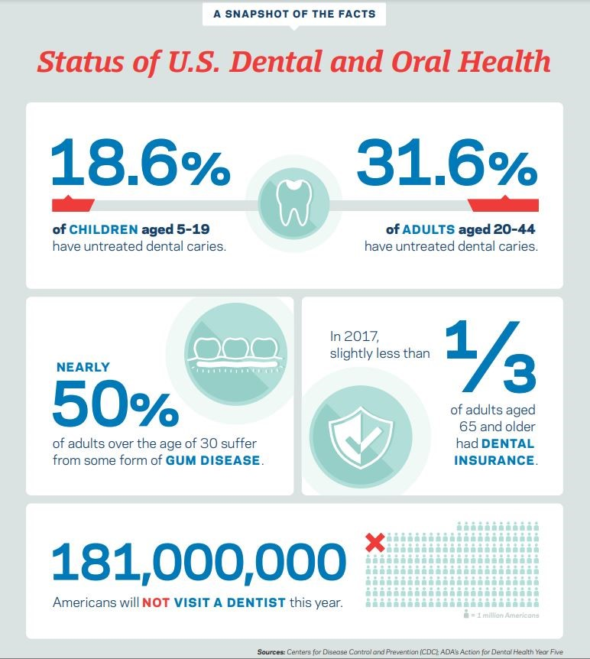
Barriers to care
Licensure reform
Midlevel providers
Barriers to care
Dental student debt
Opioids
Vaccinations
The impact of barriers to care
Notes:
This infographic highlights the consequences of barriers to care.

Slide 18
Barriers to Care: What can we do?
Licensure reform
Midlevel providers
Barriers to care
Dental student debt
Opioids
Vaccinations
  Promote oral health education
  Participate in efforts to impact public oral health like Medicaid expansion or Children’s Health Insurance Programs
  Evidence-based measures that are efficacious and sustainable in reducing barriers to care like Emergency Room referral programs
  Teledentistry
  Student loan forgiveness programs for working in rural or underserved areas
  Initiatives and legislation that improve the oral health of those with special needs.
Notes:
ASDA adopted two policies for dental students to be involved in the reduction of barriers to care:
H-1 Student Involvement to Address Barriers to Care: The American Student Dental Association encourages the participation of interested dental students in efforts to impact the oral health of the public through projects, education, internships, externships and outreach to underserved populations.
H-2 Evidence-Based Solutions for Barriers to Care: The American Student Dental Association supports evidence-based measures that are efficacious and sustainable in reducing barriers to care in underserved communities. These measures include, but are not limited to, early intervention, Medicaid expansion and co-location of health services.

Slide 19
Barriers to Care: ASDA’s efforts
Licensure reform
Midlevel providers
Barriers to care
Dental student debt
Opioids
Vaccinations
Ensuring Lasting Smiles Act (ELSA)
  Nearly 1,000 letters were sent to Congress urging their support
  ASDA lobbied for this at the 2019, 2021 and 2022 ADA Dentist and Student Lobby Day
ASDA supports various other barriers to care bills in ASDA Action
Notes:
The Ensuring Lasting Smiles Act ensures children born with congenital anomalies or birth defects receive the medical attention they need. These necessary services affect one in every 33 children in the United States, and often include severe oral and facial defects.

Slide 20
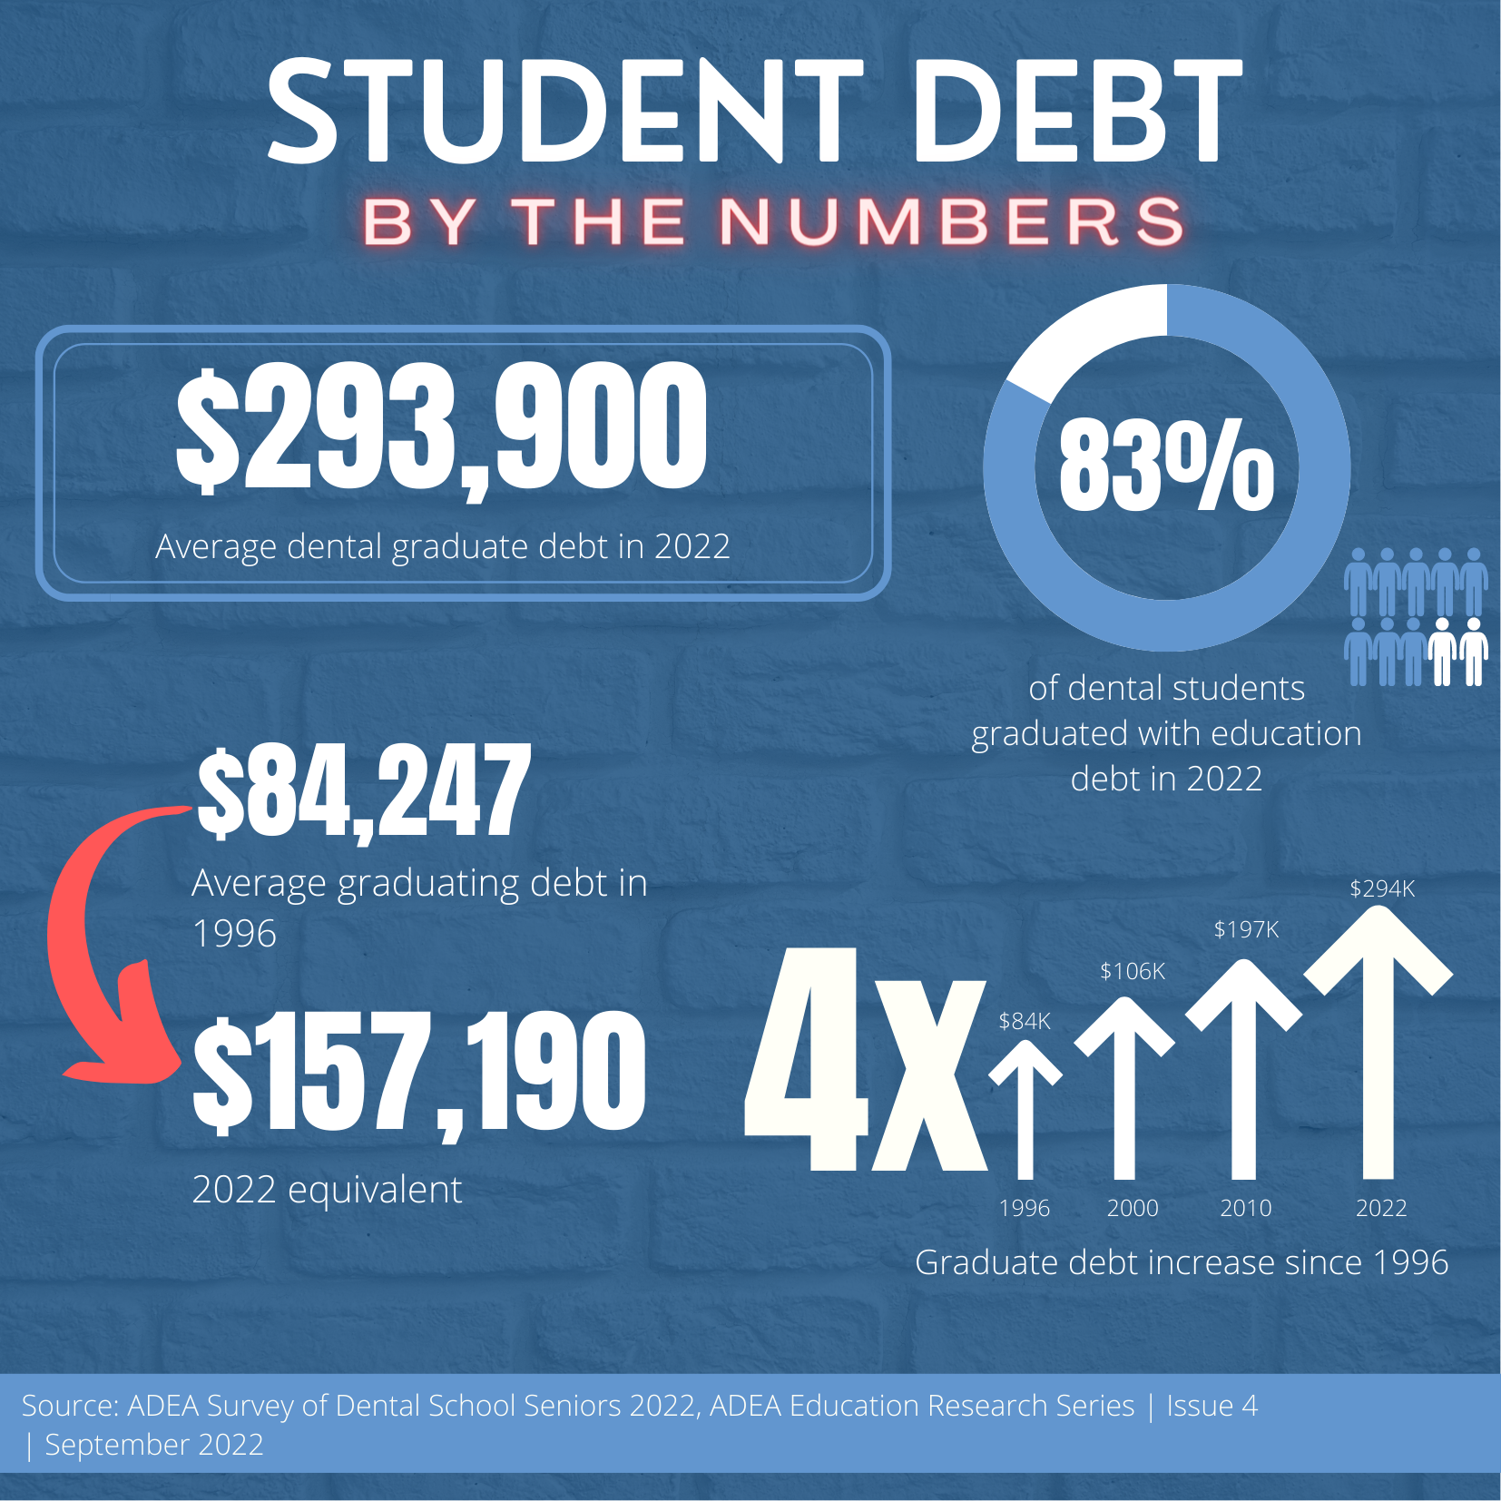
Student debt
Licensure reform
Midlevel providers
Barriers to care
Dental student debt
Opioids
Vaccinations
Dental student debt in 2022
Notes:
This infographic shows the staggering amount of debt dental students face upon graduation.
Statistics were taken from ADEA’s Survey of Dental Seniors and ADEA’s Money Matters, Educational Debt webpage.

Slide 21

Dental student debt: ASDA’s Position
Licensure reform
Midlevel providers
Barriers to care
Dental student debt
Opioids
Vaccinations
Encourage Congress and state legislatures to introduce and pass measures that include, but are not limited to:
  Reducing student loan interest rates
  Providing refinancing opportunities to borrowers
  Providing opportunities for loan forgiveness, scholarships, grants and tax deductibility
Notes:
ASDA’s advocacy strategy is focused on lobbying for financially sustainable solutions to reduce student debt for recent graduates.

Slide 22

Dental student debt: ASDA’s Position
Licensure reform
Midlevel providers
Barriers to care
Dental student debt
Opioids
Vaccinations
Continued:
  Scholarship opportunities for dental students and residents practicing in underserved areas after graduation;
  Tax deductibility and rebates for dentists practicing in underserved areas;
  Prohibiting the compounding of interest during loan repayment and the capping of interest rates upon graduation;
Notes:
ASDA’s advocacy strategy is focused on lobbying for financially sustainable solutions to reduce student debt for recent graduates.

Slide 23

Dental student debt: ASDA’s efforts
Licensure reform
Midlevel providers
Barriers to care
Dental student debt
Opioids
Vaccinations
  The Resident Education Deferred Interest (REDI) Act
  Student Loan Refinancing Act
  Student Loan Refinancing and Recalculation Act
Notes:
These are bills ASDA has supported:
The Resident Education Deferred Interest (REDI) Act. This legislation would allow medical and dental residents to defer their student loans, interest-free, during residency. This measure would save residents a significant amount of money in the long run. ASDA lobbied for this bill at Lobby Day in DC in 2021, 2022 and in 2023- after it was re-introduced to Congress in February 2023.
ASDA has an ASDA Action campaign set up so you can send letters directly to your legislators urging they support the REDI act.
At past ASDA and the ADA’s annual Lobby Day students and dentists have come together to lobby members of Congress in support of two bills pertaining to student loans.
Student Loan Refinancing Act
Student Loan Refinancing and Recalculation Act

Slide 24

Opioids: ASDA’s policy
Licensure reform
Midlevel providers
Barriers to care
Dental student debt
Opioids
Vaccinations
ASDA’s B-13 policy on evidence-based prescribing encourages:
  All dental schools to provide education on evidence-based prescribing
  Dental schools to provide resources for dentals students to appropriately and effectively address opioids with their patients
  ADEA to create resources that establish evidence-based prescribing practices for dental school clinics
Notes:
ASDA wants to ensure students are able to effectively discuss opioids with their patients. ASDA’s B-13 policy states:
The American Student Dental Association encourages all dental schools to provide education on evidence-based prescribing as outlined in the CODA-accreditation Standards.
ASDA urges dental schools to provide resources for dental students to appropriately address opioids with their patients.
ASDA encourages the American Dental Education Association to create resources that establish evidence-based prescribing practices for dental school clinics.

Slide 25

Opioids: ASDA’s efforts
Licensure reform
Midlevel providers
Barriers to care
Dental student debt
Opioids
Vaccinations
ASDA has lobbied with the ADA to create opioid legislation that:
  Requires continuing education for opioid prescribers
  Imposes prescribing limits of no more than 7 days for initial treatment of acute pain
  Supports use of PDMPs (prescription drug monitoring programs)
  Improves quality, integrity and interoperability of state PDMPs
ASDA supports several pieces of legislation in ASDA Action preserving patients’ right to know and understand opioids’ risks
Notes:
Audience: Chapter members

Slide 26
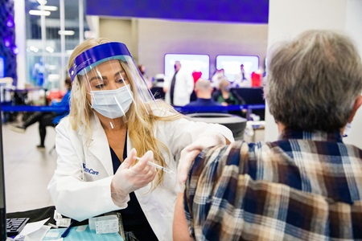
Vaccinations: ASDA’s stance
Licensure reform
Midlevel providers
Barriers to care
Dental student debt
Opioids
Vaccinations
  Oral health = systemic health
  Dental students and dentists play a vital role in explaining evidence-based medicine and vaccinations
  ASDA’s House of Delegates has adopted 3 policies that discuss vaccines:
    ASDA H-11 policy
    ASDA I-2 policy
    ASDA I-3 policy
Notes:
As the connection between oral and systemic health strengthens, it is important for dental students to understand how vaccinations play a critical role in stopping communicable diseases. With the rise of the COVID-19 pandemic, discussions about administering and receiving vaccines has come to the forefront of many within organized dentistry and beyond. Dental students and dentists will play a vital role in explaining evidence-based medicine to patients and advocates of the anti-vaccinations movement.
ASDA’s H-11 policy supports the ADA Policy on Vaccine Administration. The policy also encourages dental schools to incorporate vaccine administration into their curricula and to administer vaccinations in clinical settings, when appropriate.
ASDA’s I-2 policy supports the Centers for Disease Control and Prevention (CDC) current recommendation that dental students be vaccinated, given their risk for contracting serious, and sometimes deadly, diseases. ASDA also encourages dental schools to provide and help subsidize vaccine-preventable diseases screening and vaccine administration.
ASDA's I-3 policy supports compliance with the current CDC guidelines for vaccines, recommends that dental schools urge patients to follow CDC guidelines for vaccines, and encourages dental schools to provide patient education on vaccines as a scientifically-proven safe and effective measure of preventing communicable diseases.

Slide 27
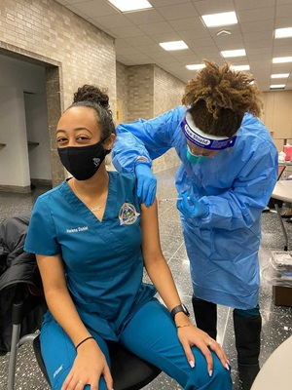
Vaccinations: ASDA’s efforts
Licensure reform
Midlevel providers
Barriers to care
Dental student debt
Opioids
Vaccinations
  On Dec. 16, 2020, ASDA and 24 other dental and healthcare organizations sent a letter to the Centers for Disease Control and Prevention (CDC) requesting clarification to include dental, autopsy, and laboratory personal for priority access to receiving the COVID-19 vaccine.
  Launched Student Spotlight social media series highlighting dental students administering the vaccine
  Developed evidence-based talking points to use when discussing vaccinations, and the COVID-19 vaccine, in particular.

Slide 28


ASDA advocacy: next steps
  Participate in Advocacy Month
  Read ASDA’s Advocacy Brief
  Send letters to Congress via ASDA Action
  Attend local advocacy events
  Participate in the Advocacy Certificate Program
Notes:
Encourage continued involvement in ASDA’s advocacy efforts.
Advocacy Month:
Make sure your chapter is hosting at least one event during Advocacy Month
Advocacy Brief
Stay up-to-date on important legislative and regulatory activities and political affairs related to dentistry.
Send letters via ASDA Action
Send letters, research bills, look up candidates or elected officials
Attend local advocacy events, ASDA national conferences
Advocacy sessions at national meetings
Advocacy Certificate Program
Participate in the program that acknowledges your advocacy contributions by earning points by participating in various advocacy initiatives (like attending this lunch & learn), sending ASDA Action letters, etc.

Slide 29
Thank you!
#ASDAadvocacy
Notes:
FOR FACILITATOR:
The following slides will give basic overview of some of the issues ASDA advocates for. Feel free to expand on any of the issues and dive deeper.
For all of ASDA’s issues and legislative priorities, visit https://www.asdanet.org/index/get-involved/advocate/issues-and-legislative-priorities

