Slide 1
Legislative Lunch and Learn
(Your name, chapter and year)

Slide 2
ADPAC is the American Dental Political Action Committee
ADPAC is the bipartisan legislative arm of the American Dental Association that:
Provides a political voice for thousands of dentists and dental students who care about their patients and the profession
Works to elect congressional candidates who support dentistry
Works with dentists who seek public office at local, state and national levels.

Slide 3
What is a ‘PAC’?
Political Action Committees allow for like-minded citizens to pool small amounts of money into a common fund.
Money is contributed to candidates who support their cause.
Every politically involved organization has a PAC.

Slide 4
Why do we have a PAC?
Congress introduces more than 3,000 bills each year that can affect patients, practices, the dental profession and the public.
ADPAC combines the resources of dentists across the country to make a substantial impact on public policy.
By pooling resources, dentists and dental students have a broader, more sustained impact on the political process.

Slide 5
Who can participate in ADPAC?
Members of the ADA and its affiliates who are U.S. citizens or permanent Green Card holders residing in the U.S.
U.S. dental students
The committee’s support is non-partisan.
Support is based on the positions and voting records of candidates, with an eye to issues that matter to dentists, patients and the public.
What candidates does ADPAC support?

Slide 6
Why do candidates value ADPAC contributions?
The top priority for an elected official is re-election.
In the 2022 Election Cycle, ADPAC spent $1,750,000 and helped 283 candidates, including 42 first-time candidates.
Lawmakers provide an attentive ear to organizations
who help them get re-elected.
Notes:
Source: https://www.ada.org/-/media/project/ada-organization/ada/ada-org/files/advocacy/ada_2022_lobby_accomplishments.pdf?rev=da0b8ddcb7794f348c1ae9c4a79439d3&hash=5E469403E3FCC4DBD3E716AB0FAE2227

Slide 7
How ADPAC benefits you
ASDA and ADA lobbyists are able to communicate concerns of the profession to lawmakers who are involved in drafting and voting on health care legislation.
ADPAC gives dentists and dental students “One Voice United” in Washington, D.C.
ADPAC ensures that
dentistry has a voice on Capitol Hill

Slide 8
How ADPAC benefits you
ADPAC advocates for health care legislation that affects:
Student loan scholarships and loan repayment programs
Expanding community dental health programs
Dental faculty recruitment and retention
Reimbursement rates for dentists
Workforce diversity
Small Business Laws
Scope of Practice

Slide 9
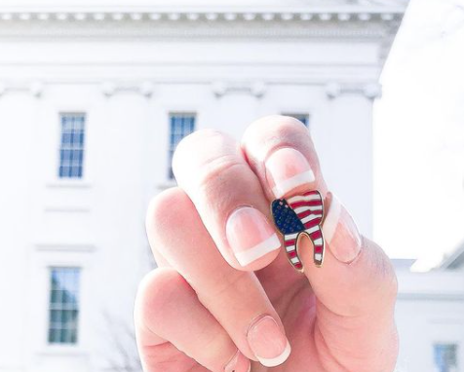
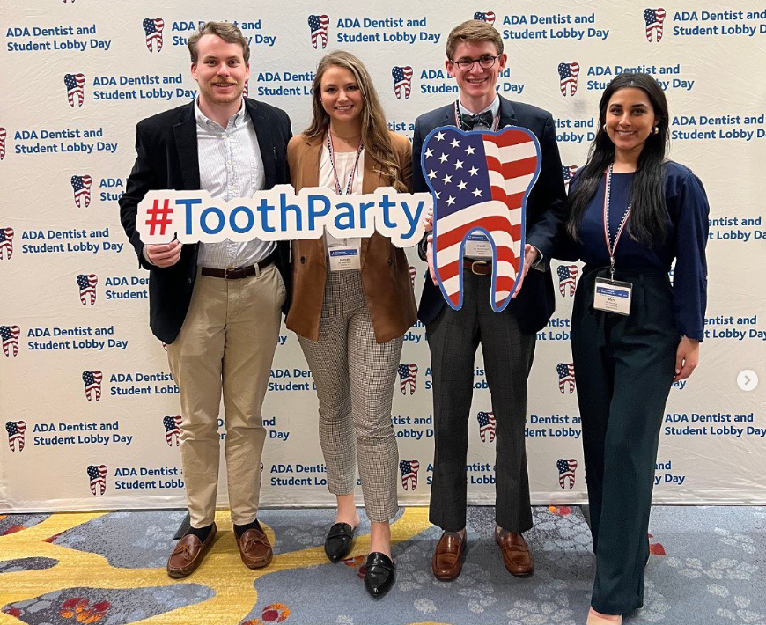
ADPAC and #ToothParty
ADPAC ≠ Democratic Party
ADPAC ≠ Republican Party
ADPAC = The Tooth Party
#ToothParty is the official hashtag of the ADA’s Dentist and Student Lobby Day
Notes:
The Tooth Party is a movement promoting the idea that together, we are neither democrat nor republican but rather, we come together to represent the issues that affect the dental profession.

Slide 10
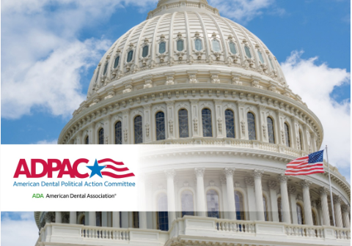
ADPAC Accomplishments in 2023
Educated 700 dentists and students on advocacy and legislative issues during the 2023 ADA Dentist and Student Lobby Day.
Held over 325 meetings with Members of Congress during the 2023 ADA Dentist and Student Lobby Day.
Notes:
Source: https://www.ada.org/publications/ada-news/2023/march/lobby-day-kicks-off-in-Washington

Slide 11
Why should I join ADPAC?
What is happening on Capitol Hill most certainly affects you as a future dentist:
Where you practice
Who compensates you
The materials you will use
How you practice
What your staff can and can’t do
“Our political involvement is as critical as any continuing education we might take.”
– Dr. Jeff Parrish,
former ADPAC Chairman

Slide 12
Why should I join ADPAC?
Joining ADPAC as an ADA student member is an investment for yourself and your future!
ADA student membership = only $5
Student Capitol Club membership = $50
Membership goes for the academic year.

Slide 13
What does my $5 do?
Legislators don’t want to make laws for all dentists if they think ADPAC’s opinions only represent a minority of the profession.
A greater percentage of member representation gives dentistry political leverage.
ADPAC does not “buy votes” – these monies go to candidates’ campaigns who support oral health initiatives

Slide 14
ADPAC and ASDA Advocacy
ASDA’s Advocacy Mission Statement:
ASDA represents the interests of dental students on legislative and regulatory issues that impact the dental profession. ASDA launches grassroots initiatives to promote action-oriented advocacy in support of dental students and the patients they serve.
ASDA encourages members to advocate for their interests as future dentists- ADPAC affords dental students the opportunity to make their voice heard in Washington, D.C.
Notes:
Source: https://www.asdanet.org/index/get-involved/National-Leadership-Positions/Council-on-Advocacy

Slide 15
Get involved
Visit the ADPAC website.
Contact your chapter’s Legislative Liaison for ADA information.

