Slide 1
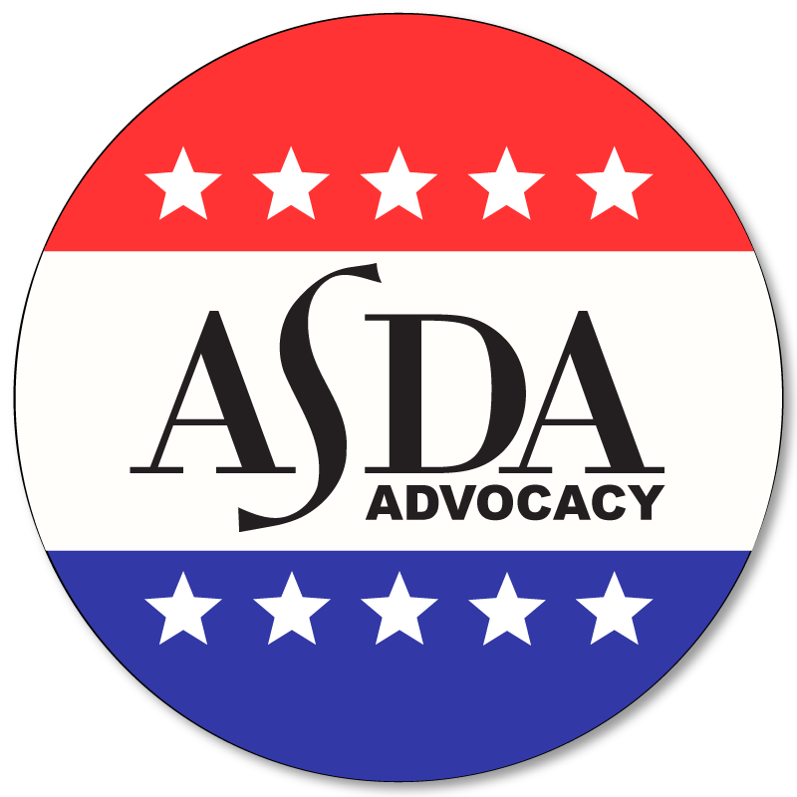
A Guide to
Midlevel providers
ASDA Advocacy presents

Slide 2
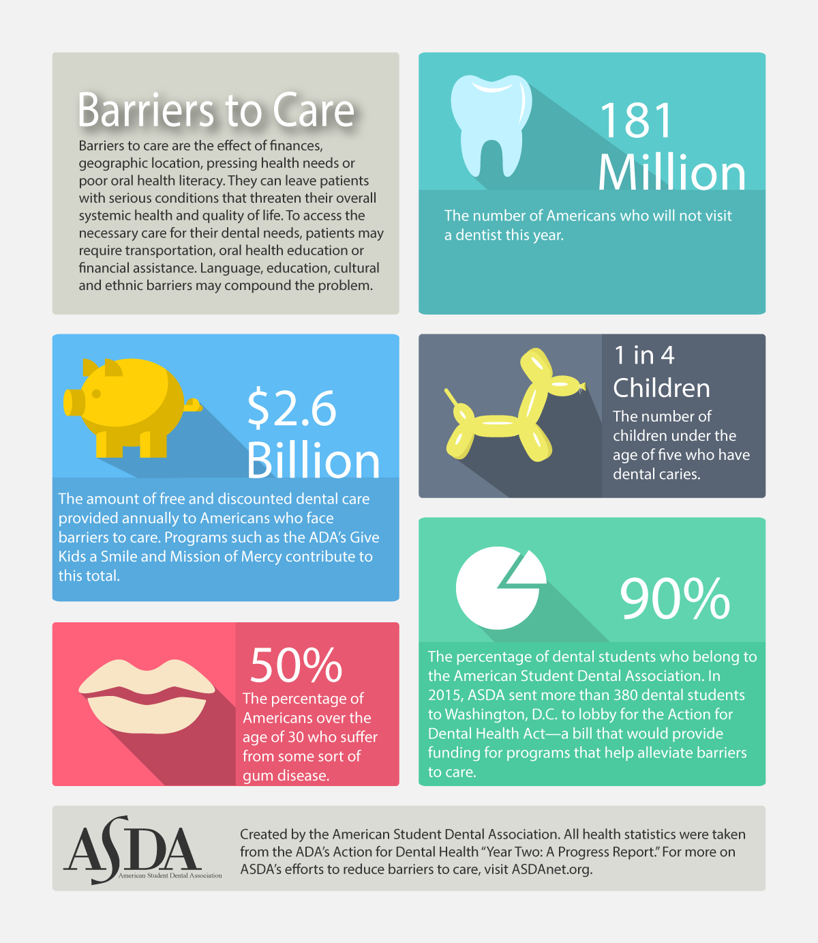
barriers to care
Barriers to care include anything that limits or prevents people from receiving adequate health care. The most common are:
  financial hardship
  geographic location
  pressing health needs
  poor oral health literacy
Notes:
Notes:
To understand midlevel providers, we need to first discuss barriers to care.
Language, education, cultural and ethnic barriers may compound barriers to care. In many cases, multiple issues are involved. To access the necessary care for their dental needs, patients may require transportation, oral health education and/or financial assistance.
Statistics are taken from the ADA’s Action for Dental Health Year Two: A Progress Report (2015).

Slide 3
Why does this matter?
There are 5,493 Dental Health Professional Shortage Areas (HPSA).
More than 16.5 million children in the U.S. were not taken to a dentist in 2009.
Notes:
Notes:
It would take 7,300 additional practitioners to meet every HPSA community's need for dental providers (a population to practitioner ratio of 5,000:1).
47 million Americans are affected by barriers to care.
29 states and 53 other countries permit expanded function to dental assistants.
Statistics are taken from the ADA’s Action for Dental Health Year Two: A Progress Report (2015).

Slide 4
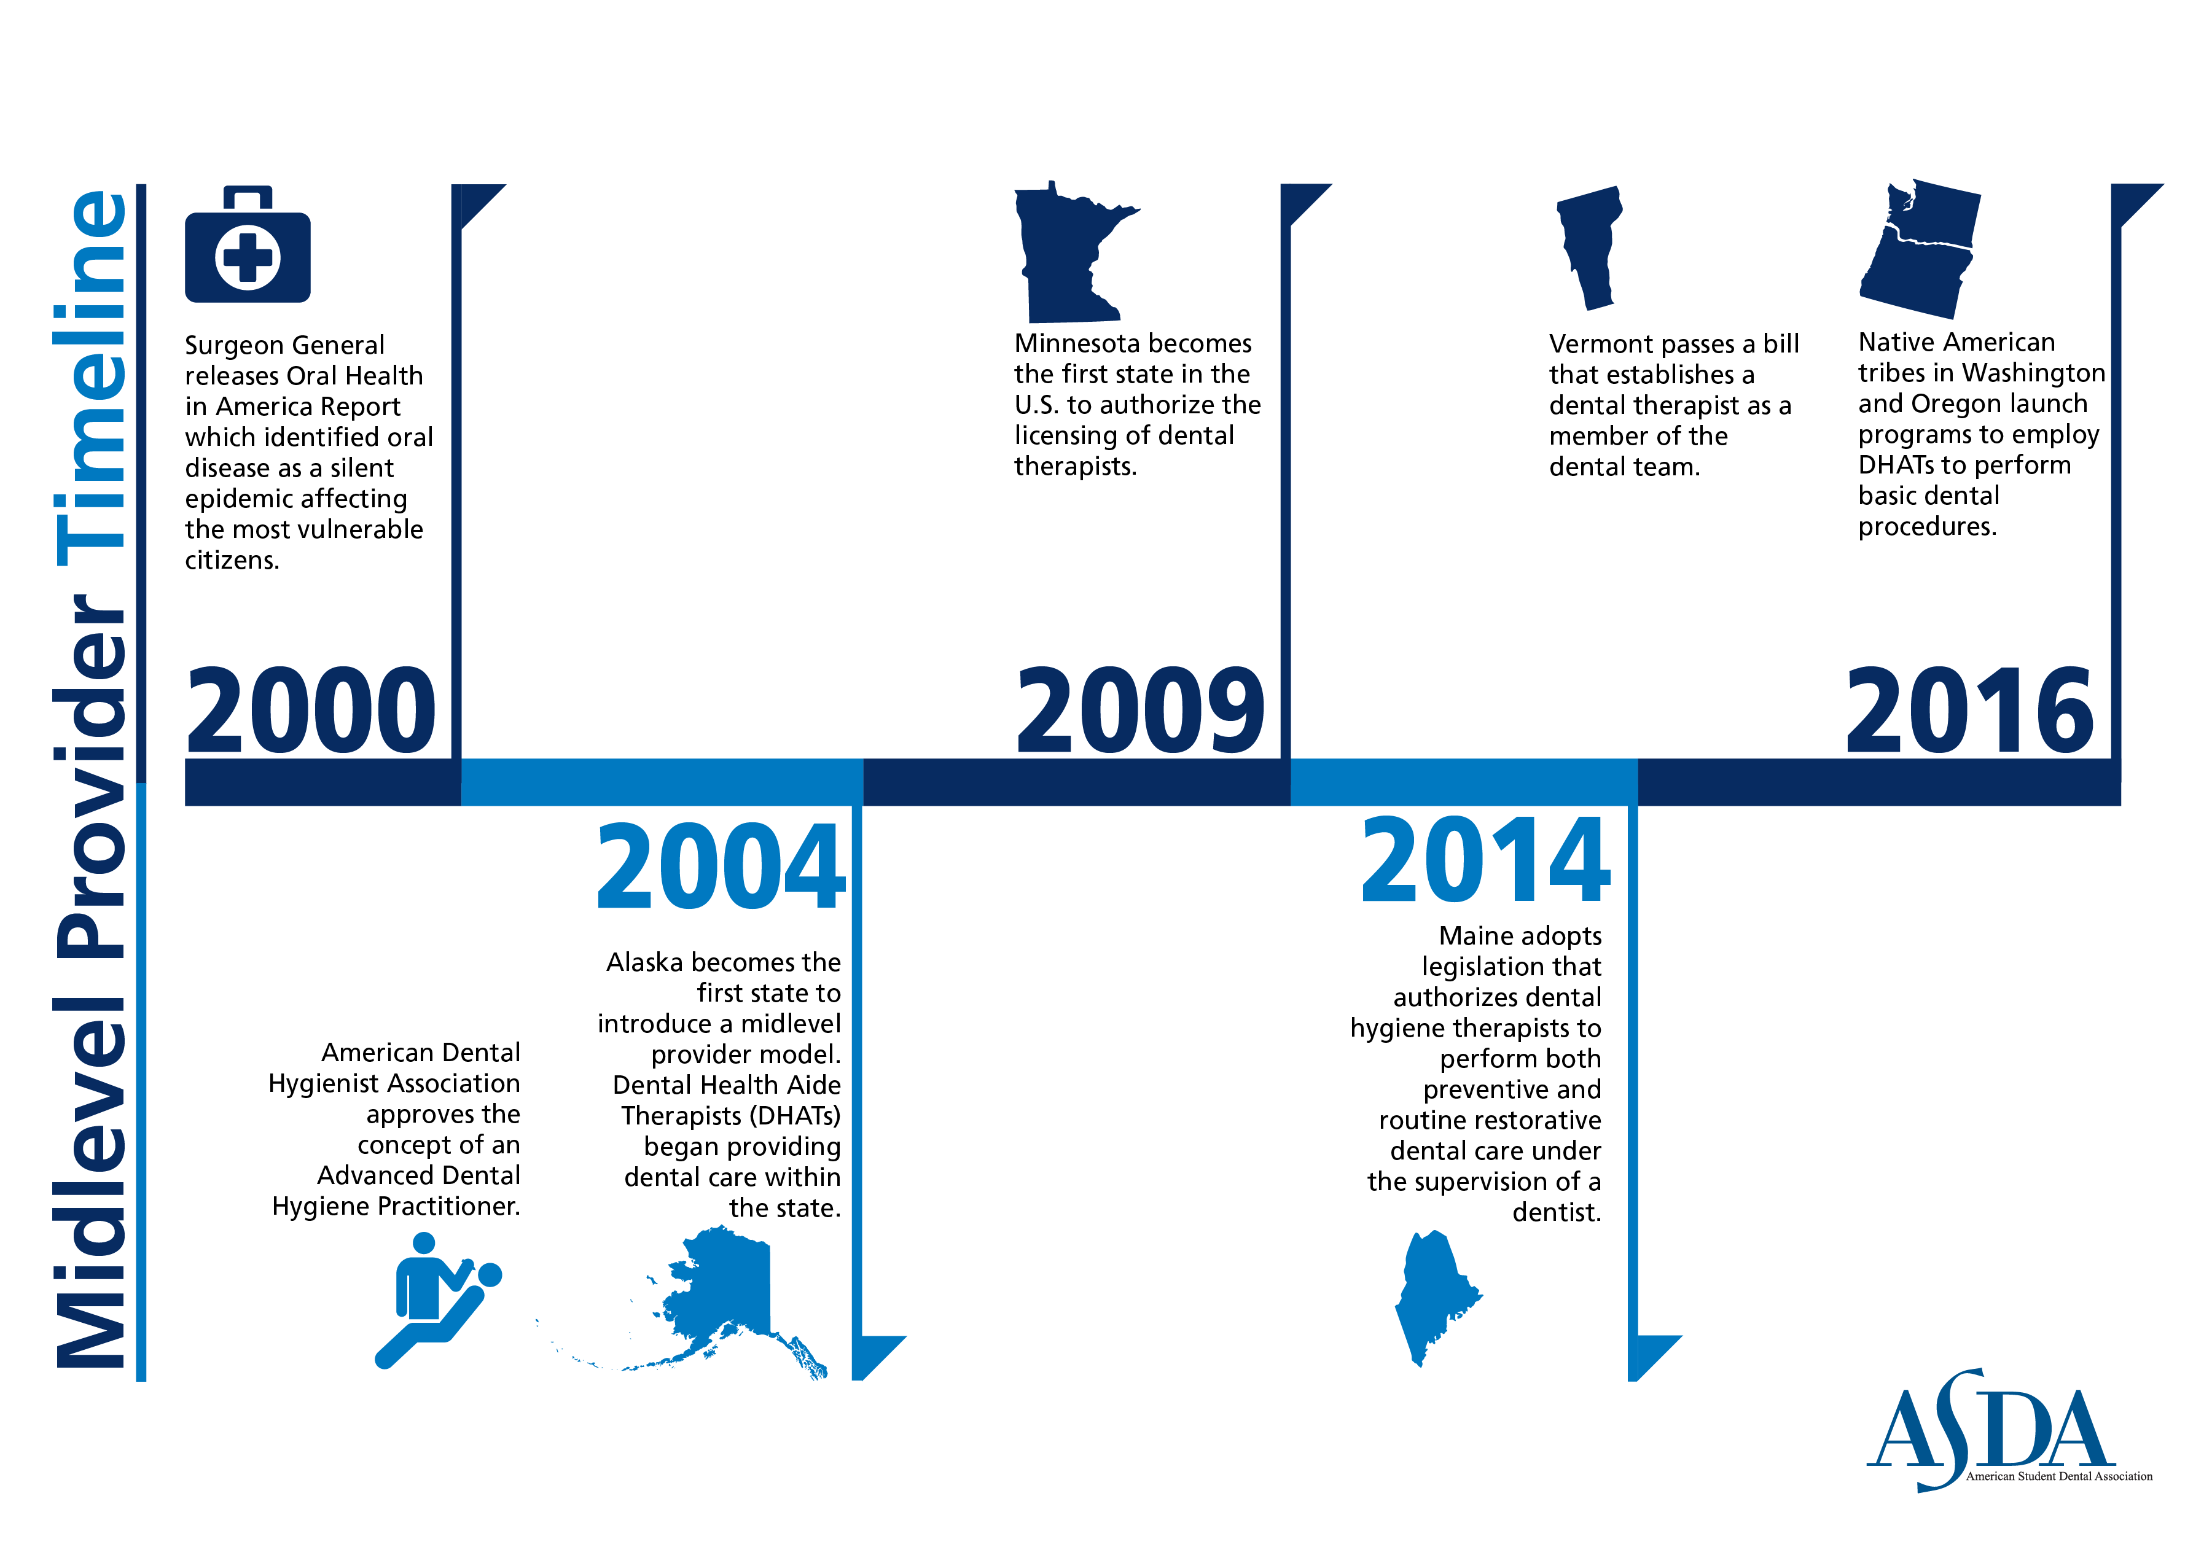
10
Notes:
Due to these concerns, one of the proposed solutions was adding this position to the dental team to conduct irreversible procedures in underserved communities.
54 countries worldwide have the dental therapists model- ie. New Zealand, Australia, England, Canada, Netherlands etc.
In 2000, the U.S. surgeon general called a lack of access to oral health care “a silent epidemic.”
1st used in the U.S. by the Alaska Native Tribal Health Consortium
2005- Alaskan students became dental heath aide therapists under tribal authority
2009 - Minnesota became the 1st state to adopt dental therapist
Minnesota created 2 levels of midlevel providers: Dental Therapists and Advanced Dental Therapists
Provide basic preventative and limited restorative services- also can prescribe
“Limited to primarily practicing in settings that serve low-income, uninsured, and underserved patients or in dental health professional shortage areas”
Dentist does not need to be present at time of procedures
February 2014- There are 32 licensed dental therapists- 6 are ADT, 4,027 Dentists in-state, 5,542 hygienists
2014- Maine passes law for direct supervision of dental therapists by dentists
Alaska, Minnesota, Maine and Vermont all have authorized some version of a dental therapist

Slide 5
Current alternative workforce models
Dental Aide Therapist
Dental Therapist/ Advanced Dental Therapist
Dental Hygiene Therapists
17

Slide 6

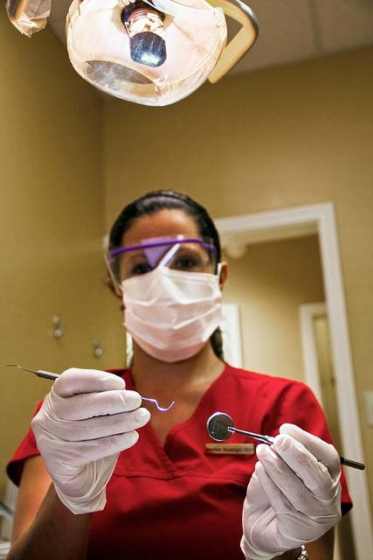
How does asda define midlevel providers?
  An individual, who is not a dentist with four years of post-collegiate education (three years in the case of University of the Pacific School of Dentistry), who may perform irreversible procedures on the public.
5

Slide 7
ASDA’s stance
Only a qualified dentist should perform the following functions, including but not limited to:
  Diagnosis and treatment planning
  Prescribing work authorizations
  Performing irreversible dental procedures
  Prescribing drugs and/or other medications
17

Slide 8
Organized dentistry’s view
American Dental Association
Academy of General Dentistry
American Academy of Pediatric Dentistry
National Dental Association: 2010 position paper
16
Notes:
Source: https://www.ncbi.nlm.nih.gov/pmc/articles/PMC3222362/
ADA: Against
AGD:
“Because underserved patients often exhibit a greater degree of complications and other systemic health conditions, the use of lesser-educated providers risks jeopardizing the patients’ health and safety.”
“This approach will provide lesser-quality care to the poor.”
AAPD:
“Dental Therapists working under the supervision of dentists … are conceptually compatible with AAPD core values, oral health policies and clinical guidelines, and definition of the dental home… AAPD supports the use of mid-level dental providers who perform or assist in the delivery of specified reversible procedures and certain surgical procedures under the general supervision of a dentist, provided that such arrangements have been thoroughly evaluated and demonstrated to be safe, effective, and efficient and to not compromise quality of care in similar settings.”
NDA: This [institutionalizing dental therapists] seems an acceptable solution for the poor and underserved, while those well-to-do individuals in our society enjoy comprehensive oral health care from licensed dentists.

Slide 9
concerns about dental therapists
Will dental therapists actually expand access to care?
Is two years of training enough for irreversible procedures?
15
Notes:
Notes:
Dental therapists may populate urban areas instead of the rural areas thereby not increasing access in all areas. Studies have shown that the biggest barrier is finance and not supply
While some procedures are common and uncomplicated, dental therapists receive only 3 academic semesters of education, rivaling the 8 semesters that dentists receive. This may leave them unequipped or trained to deal with procedural complications or medically complex patients.

Slide 10
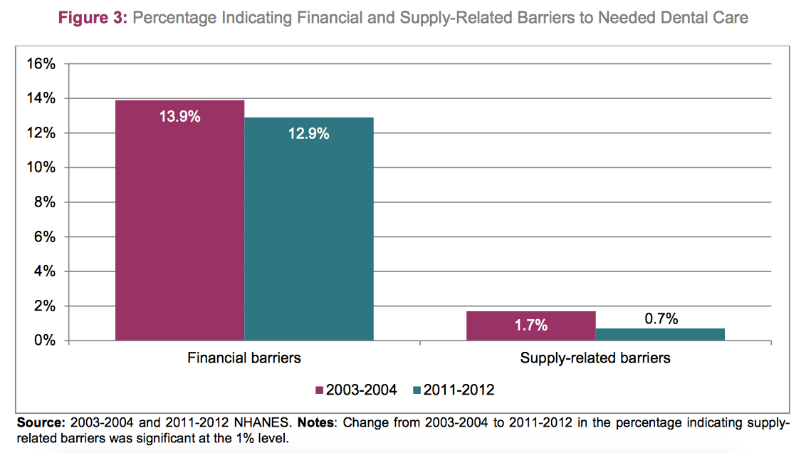
14
Notes:
Source: Wall, Thomas, Kamyar Nasseh, and Marko Vujicic. Most Important Barriers to Dental Care Are Financial, Not Supply Related. Issue brief. American Dental Association, Oct. 2014. Web.
The solution isn’t saturating the market with more dental providers. It is important to ensure all patients receive the same quality of care and

Slide 11
Alternative Proposals to Midlevel Providers
ADA’s Action for Dental Health Initiative
Community Dental Health Coordinators
Preventative care and early intervention
ER Referral programs
Teledentistry
18
Notes:
Sources:
Wall, Thomas, Kamyar Nasseh, and Marko Vujicic. Most Important Barriers to Dental Care Are Financial, Not Supply Related. Issue brief. American Dental Association, Oct. 2014. Web.
Action for Dental Health Care Act:
Expands care to underserved areas through grants provided by CDC
Last year more than 375 ASDA students advocated for this legislation during Lobby Day!

Slide 12
Alternative proposals to Midlevel Providers
Children’s Health Insurance Program
Increase Medicaid reimbursement rates
Extend Medicaid coverage of procedures
Decrease student loan burden to increase dental providers
Increase health service corps job opportunities for dentists in underserved areas
Encourage increase participation in outreach programs such as Give Kids a Smile and Mission of Mercy
18
Notes:
Sources:
Wall, Thomas, Kamyar Nasseh, and Marko Vujicic. Most Important Barriers to Dental Care Are Financial, Not Supply Related. Issue brief. American Dental Association, Oct. 2014. Web.

Slide 13

Current Legislation
HR 2422 (support): A bill to the Public Health Service Act to improve essential oral health care for low-income and underserved individuals by breaking down barriers to care, and for other purposes.
Notes:
On the state level: ASDA monitors legislation that introduces midlevel providers. ASDA also supports legislation that supports our recommended solutions. Stay up-to-date by reading ASDA’s Advocacy Brief.

Slide 14

What can you do?
Stay informed
  ASDA Engage website
    ASDA’s advocacy alert system.
  Advocacy Brief
    ASDA’s monthly newsletter devoted to legislative updates.
Participate in Advocacy Month each November
Attend the national lobby day
Notes:
Notes:
We encourage you to get involved and have a voice in this issue. Here are a few ways:
Sign up for Engage to receive alerts on important bills, send letters to your representatives with a few simple clicks and read up on issues affecting your state and the profession.
Stay up to date on student debt developments by reading Advocacy Brief, an electronic publication sent once a month.
Attend the ADA Dentist and Student Lobby Day held annually in DC in the spring. Training on the issues and how to lobby is provided on the first day. The second day is spent meeting with legislators.

Slide 15
Advocate for your future
ASDA’s Council on Advocacy
Email advocacy@asdanet.org to determine what you can do to advocate for your future.
20

Slide 16

resources
ADEA Alternative Workforce Models Chart
ADA Workforce Statement: “Breaking Down Barriers to Oral Health for All Americans: The Role of Workforce”
ADA Workforce Statement: "Breaking Down Barriers to Oral Health for All Americans: Repairing the Tattered Safety Net"
ADA comment on the Kellogg Foundation Report, "A Review of the Global Literature on Dental Therapists"

Slide 17

Questions?

