Slide 1

ASDA Advocacy presents:
A Guide to Midlevel Providers

Slide 2
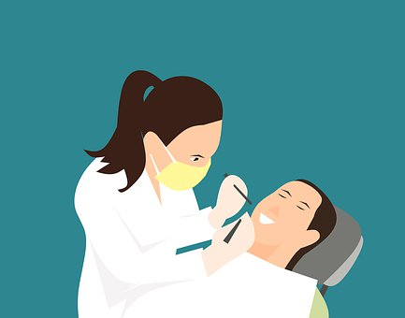
What are midlevel providers
ASDA defines a midlevel provider as an individual, who is not a dentist with four years of post-collegiate education (three years in the case of University of the Pacific School of Dentistry), who may perform irreversible procedures on the public.

Slide 3

What are midlevel providers
Midlevel dental providers could include any of the following:
  Dental therapist
  Dental health aide therapist
  Advanced dental therapist

Slide 4

ASDA’s Stance
ASDA’s C-2 policy on dental providers states only a qualified dentist should perform the following functions, including but not limited to:
  Diagnosis and treatment planning
  Prescribing work authorizations
  Performing surgical/irreversible dental procedures
  Prescribing drugs and/or other medications

Slide 5
History of midlevel providers
Midlevel Providers were created in response to barriers to care and the Dental Health Professional Shortage Area crisis.
Barriers to Care:
  Limit or prevents people from receiving adequate health care.
  The most common are:
    financial hardship
    geographic location
    pressing health needs
    poor oral health literacy
There are 7,192 Dental Health Professional Shortage Areas.
  More than 11,896 practitioners are needed to meet every HPSA community’s need.
Notes:
Source/s:
Information on Midlevel Providers and Barriers to Care are from ADA Action for Dental Health, year two, a progress report.
Dental Health Professional Shortage Area statistics are taken from the Kaiser Family Foundation: https://www.kff.org/other/state-indicator/dental-care-health-professional-shortage-areas-hpsas/

Slide 6
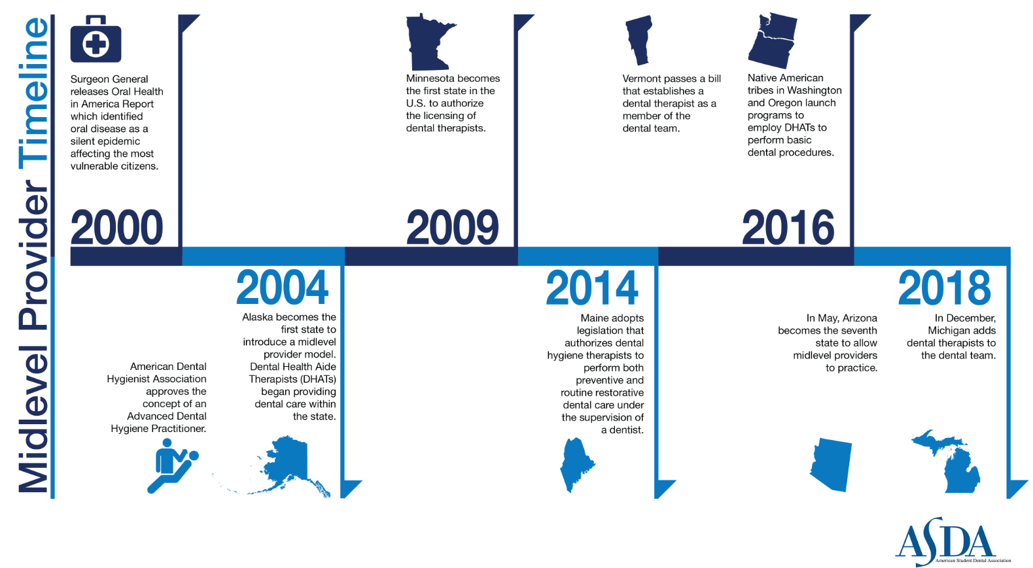
Notes:
54 countries worldwide have the dental therapists model- ie. New Zealand, Australia, England, Canada, Netherlands etc.
In 2000, the U.S. surgeon general called a lack of access to oral health care “a silent epidemic.”
States have developed different kinds of midlevel providers.
State law outlines the practice setting and kinds of procedures midlevels can perform.
2009 - Minnesota became the 1st state to adopt dental therapist
Minnesota created 2 levels of midlevel providers: Dental Therapists and Advanced Dental Therapists
Provide basic preventative and limited restorative services- also can prescribe
“Limited to primarily practicing in settings that serve low-income, uninsured, and underserved patients or in dental health professional shortage areas”
Dentist does not need to be present at time of procedures
February 2014- There are 32 licensed dental therapists- 6 are ADT, 4,027 Dentists in-state, 5,542 hygienists

Slide 7
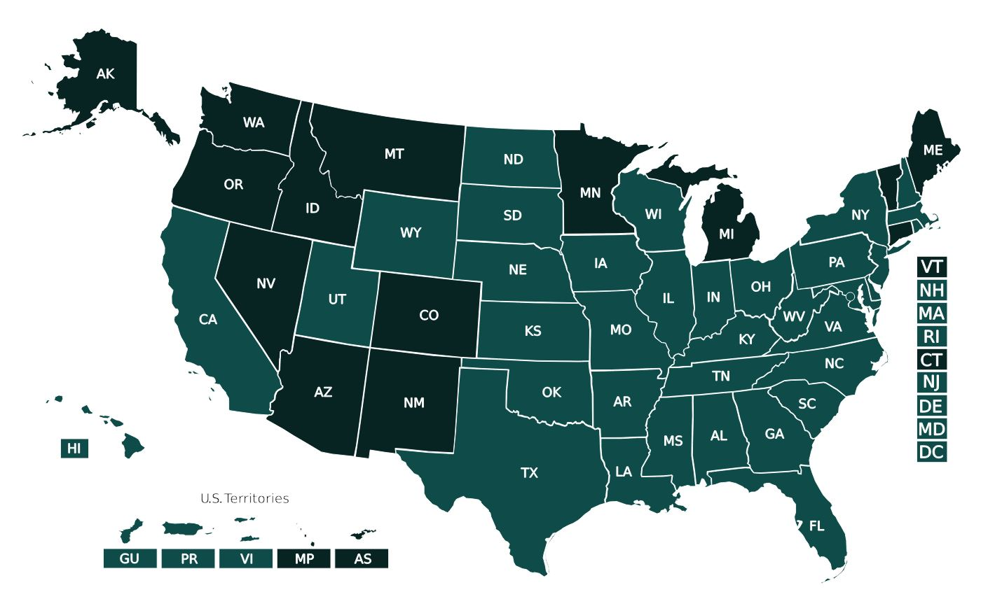

Midlevel Providers by State
Dental therapists are currently recognized in 13 states and two territories.
Notes:
Source:
https://scopeofpracticepolicy.org/practitioners/oral-health-providers/sop/dental-therapists/
As of May 2023, Licensed Dental Therapists will be able to practice in Colorado.

Slide 8
History of states and midlevel providers
State | Year | Midlevel Provider | Scope
Alaska | 2004 | Dental Health Aide Therapist | Diagnosis and treatment planning Community based oral health preventative care and education Basic restorations Cleanings Non-surgical extractions
Minnesota | 2009 | Dental Therapist; Advanced Dental Therapist | Perform all dental therapist functions with supervision of a dentist Oral evaluation and assessment Treatment plan formulation Non–surgical extraction of certain diseased teeth
Maine | 2014 | Dental Hygiene Therapist | Preventative services Routing restorative dental care

Slide 9
History of states and midlevel providers
State | Year | Midlevel Provider | Scope
Oregon | 2016 | Dental Hygiene Therapist | Oral exams Preventative dental services Restoration Stainless steel crowns X-rays Extractions Root canal procedures
Michigan | 2018 | Dental Therapist | Oral exams Prophylaxis Dispense and administer oral and topical non-narcotic analgesics and anti-inflammatory and antibiotic medications Administer nitrous oxide Periodontal services

Slide 10
Midlevel Providers in practice
Dental Health Aide Therapists
In 2004, Alaska became the first state to adopt the midlevel provider model.
To become a DHAT, students must:
  Complete a two-year program
DHATs operate under tribal authority and their scope of practice includes:
  Diagnosis and treatment planning
  Community based oral health preventative care and education
  Basic restorations
  Cleanings
  Non-surgical extractions
Notes:
Source/s:
DHAT information is sourced from https://anthc.org/alaska-dental-therapy-education-programs/adtep-certification-scope-of-practice/
And
https://www.nihb.org/docs/05212014/Dental%20Health%20Aide%20Therapists%20Presentation%201.pdf

Slide 11
Midlevel Providers in practice
Dental Therapist; Advanced Dental Therapist
In 2009, Minnesota authorized midlevel providers. These providers treat patients in underserved areas.
To become an advanced dental therapist or dental therapist, students must:
  Complete a two-year program and be licensed by Board of Dentistry.
  Work under a dentist’s supervision to provide evaluative, preventive, restorative and minor surgical dental care.
Advanced dental therapists and dental therapists may perform:
  All dental therapist functions with supervision of a dentist
  Oral evaluation and assessment
  Treatment plan formulation
  Non–surgical extraction of certain diseased teeth
Notes:
Source/s:
Dental therapist information is sourced from https://www.health.state.mn.us/facilities/ruralhealth/emerging/dt/index.html

Slide 12
Midlevel Providers in practice
Dental Hygiene Therapists
In 2014, Maine adopted legislation allowing for dental hygiene therapists.
To become a dental hygiene therapist, students must:
  Possess a valid license to practice dental hygiene.
  Have successfully completed a dental hygiene therapy education program.
  Have been awarded a Bachelor of Science degree in dental hygiene.
These providers treat patients under the supervision of a dentist in a public health setting.
dental hygiene therapists may perform:
  Preventative services
  Routing restorative dental care
Notes:
Source/s:
http://scopeofpracticepolicy.org/o-h-providers/dental-hygienists-dental-hygiene-therapists-maine/

Slide 13
Midlevel Providers in practice
Dental Health Aide Therapists
In 2016, Oregon launched programs that employ DHATs that can practice on federally recognized tribal land.
To become a DHAT, students must:
  Have a high school diploma.
  Graduate from a two-year educational program.
  Complete a 400-hour clinical preceptorship under a dentist’s supervision.
DHATs may perform the following without the supervision of a dentist:
  Oral exams
  Preventative dental services
  Simple restorations
  Stainless steel crowns
  X-rays
When a dentist determines a medical emergency, DHATs may perform:
Extractions and Root canal procedures
Notes:
Information sourced from https://www.adea.org/Blog.aspx?id=36283&blogid=20132

Slide 14
Midlevel Providers in practice
Dental Therapists
In 2018, Michigan added dental therapists to the dental team.
To become a dental therapist, students must:
  Complete three academic years in an accredited dental therapy program
  Have 500 hours of clinical practice under the direct supervision of a dentist
  A comprehensive, competency-based clinical exam
  Pass a state-approved clinical exam.
  Obtain licensure
dental therapists may perform the following:
  Oral exams
  Prophylaxis
  Composite and amalgam restorations
  Administer nitrous oxide
  Dispense and administer oral and topical non-narcotic analgesics and anti-inflammatory and antibiotic medications
  Periodontal services
Notes:
Source/s:
https://www.pewtrusts.org/en/research-and-analysis/articles/2018/12/31/michigan-becomes-8th-state-to-authorize-dental-therapists
https://www.dentistrytoday.com/dental-therapy-moves-forward-in-michigan/#:~:text=Three%20academic%20years%20in%20a,comprehensive%2C%20competency%2Dbased%20clinical%20exam

Slide 15
Many dental organizations oppose the integration of midlevel providers:
  American Dental Association
  Academy of General Dentistry
  American Academy of Pediatric Dentistry
  National Dental Association
Notes:
ADA: Against
AGD:
“Because underserved patients often exhibit a greater degree of complications and other systemic health conditions, the use of lesser-educated providers risks jeopardizing the patients’ health and safety.”
“This approach will provide lesser-quality care to the poor.”
AAPD:
“Dental Therapists working under the supervision of dentists … are conceptually compatible with AAPD core values, oral health policies and clinical guidelines, and definition of the dental home… AAPD supports the use of mid-level dental providers who perform or assist in the delivery of specified reversible procedures and certain surgical procedures under the general supervision of a dentist, provided that such arrangements have been thoroughly evaluated and demonstrated to be safe, effective, and efficient and to not compromise quality of care in similar settings.”
NDA: This [institutionalizing dental therapists] seems an acceptable solution for the poor and underserved, while those well-to-do individuals in our society enjoy comprehensive oral health care from licensed dentists.

Slide 16

Concerns about midlevel providers
Will midlevel providers help alleviate barriers to care?
Does midlevel provider training equip practitioners for complex patients?

Slide 17

Dental Therapists and Barriers to Care
  Midlevel providers have been integrated into the dental health care model as a way to solve barriers to care.
  Studies show that the biggest barrier is finance and not supply.
  The integration of midlevel providers has not shown to decrease costs for patients.
  Many rural populations are underserved.
  The introduction of dental therapists has not led to an increase of providers in rural areas.
Notes:
Information referenced in:
AGD Whitepaper: https://www.agd.org/docs/default-source/policies-and-white-papers/access-to-care-white-paper.pdf?sfvrsn=d5e75b1_2
Michigan Dental Association: https://www.michigandental.org/Portals/pro/ProDocuments/Legislative/Dental%20Therapist%20Toolkit/Dental%20Therapist%20Information%20Toolkit.pdf

Slide 18

Irreversible procedures and midlevel providers
  Midlevel providers oftentimes receive two or fewer years of training.
  This may leave them unequipped to deal with procedural complications or complex patients.
  It is important for all patients to receive the same standard of care.
Notes:
For example, would a midlevel provider be able to spot oral cancer?
Source/s:
Information from American Association of Oral and Maxillofacial Surgeons White Paper: https://www.aaoms.org/docs/govt_affairs/advocacy_white_papers/policy_dental_midlevel.pdf

Slide 19

Alternative proposals to midlevel providers
  ADA’s Action for Dental Health Initiative
  Community Dental Health Coordinators
  Preventative care and early intervention
  ER Referral programs
  Teledentistry
Notes:
Sources:
https://www.ada.org/~/media/ADA/Science%20and%20Research/HPI/Files/HPIBrief_0419_1.pdf?la=en
Niodita Gupta and Marko Vujicic. Main Barriers ot Getting Needed Dental All Relate to Affordability. April 2019. Web.
Action for Dental Health Care Act was signed into law Dec. 11, 2018
Expands care to underserved areas by allowing organizations to qualify for oral health grants administered by the CDC.
ASDA members sent more than 600 letters to Congress advocating for this legislation, and nearly 500 ASDA members advocated for this bill at the ADA Dentist and Student Lobby Day in 2018.

Slide 20

Alternative proposals to midlevel providers
  Children’s Health Insurance Program
  Extend Medicaid coverage of procedures
  Decrease student loan burden to increase dental providers
  Increase health service corps job opportunities for dentists in underserved areas
  Encourage increase participation in outreach programs such as Give Kids a Smile and Mission of Mercy
Notes:
Sources:
https://www.ada.org/~/media/ADA/Science%20and%20Research/HPI/Files/HPIBrief_0419_1.pdf?la=en
Niodita Gupta and Marko Vujicic. Main Barriers to Getting Needed Dental All Relate to Affordability. April 2019. Web.
Photo credit :https://www.ada.org/en/public-programs/give-kids-a-smile

Slide 21
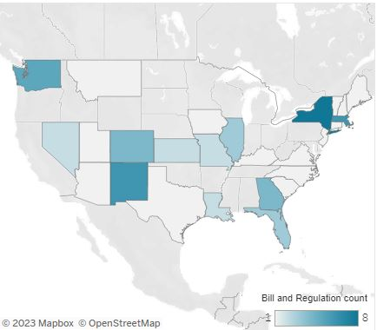

Current Legislation
ASDA monitors legislation that introduces midlevel providers.
ASDA supports legislation that aligns with our recommended solutions.
ADEA U.S. Interactive Legislative and Regulatory Tracking Map
Notes:
The ADEA Interactive Legislative and Regulatory Tracking Map provides current information on state legislation and regulations of interest to academic dentistry: https://www.adea.org/LegRegMap/
Instructions for Use
To view legislation and regulations by topic, click on the bar next to the corresponding topic of interest.
To view legislation and regulations by state, click on the outline of the state of interest.
To view more detailed information, like summaries, status or sponsor information, click on the bill or regulation.
PDFs or images of bill information can be downloaded by clicking on the download icon on the bottom right of the screen.

Slide 22

Current legislation supporting ASDA’s solutions to barriers to care
The Medicaid Dental Benefit Act
  This bill would require comprehensive dental care for adults to be part of all state Medicaid programs.
Want to show your support for this bill? Make your voice heard by sending a letter to your legislator today via ASDA Action!

Slide 23
What can you do?
  Stay informed
  ASDA Action
    View state and federal bills related to midlevel providers.
  Read Advocacy Brief
    ASDA’s monthly newsletter devoted to legislative updates.
  Find out if midlevel legislation has been introduced to your state legislature. If it has, contact your Legislative Coordinator.
  Many chapters are involved in projects like Give Kids a Smile and Missions of Mercy, which provide dental care to patients who may otherwise go untreated. Connect with your chapter leaders to see how you can get involved.
  Participate in Advocacy Month each November
  Attend the annual ADA Dentist and Student Lobby Day in Washington D.C.

Slide 24
Advocate for your future
ASDA’s Council on Advocacy
Email advocacy@asdanet.org to determine what you can do to advocate for your future.

Slide 25
Resources
  AGD: Midlevel Providers
  ADEA Interactive Legislative and Regulatory Tracking Map
  AAOMS White Paper on Midlevel Providers
  AAPD, “Analysis and Policy Recommendations Concerning Midlevel Dental Providers”
  ADA Workforce Statement: "Breaking Down Barriers to Oral Health for All Americans: Repairing the Tattered Safety Net"
  ADA Report: Do Midlevel Providers Improve Oral Health?
  ADA: Community Dental Health Coordinator

Slide 26

Questions?

