Slide 1

Licensure 101
SPEAKER NAME, CHAPTER
Notes:
USE THIS SLIDE AS YOUR OPENING SCREEN.
Note the Molar Bear in upper right corner. This is ASDA’s official advocacy mascot!
Initial dental licensure is an important topic for all dental students to understand. Decisions made today will directly influence how you receive your license. Licensure can be a complex topic. We are here to break down the issue to help you understand.

Slide 2
What is dental licensure?
Process by which dental students receive a license to practice dentistry
  There are three components:
    Education – Graduation from a CODA-accredited dental school
    Written Examination – Pass the Integrated National Dental Board Examination (INDBE). Previously NBDE parts I & II.
    Clinical Competency – Requirements vary from state-to-state
Notes:
Dental licensure is the process whereby a state grants someone the legal authority to practice dentistry in that state. Typically, fourth-year dental students complete specific requirements to obtain their dental license. (It’s only 3 years in the case of University of the Pacific Arthur Dugoni School)
All states have 3 requirements to receive a license:
All states’ educational requirements are satisfied by graduation from a dental school accredited by the Commission on Dental Accreditation (CODA).
All licensing boards use the Integrated National Board Dental Examinations (NDBE) to satisfy their written exam requirements. This multiple-choice written exam is developed by the Joint Commission on National Dental Examinations (JCNDE). (This exam combined Parts I and II of the NDBE into one exam)
Clinical competence: there are three testing agencies that administer clinical exams on manikins and live patients. This last bullet of clinical competency is going to be the focus of this presentation and the topic most discussed when discussing dental licensure.

Slide 3
Clinical competency: Explored
Dentistry is the only profession that uses live human subjects to receive a license
  The exam is not valid.
  The exam is not reliable.
  The exam tests a narrow scope of practice.
  The exam does not put the best interests of the patient first.
  The exam needlessly places candidates in positions of moral distress.
Notes:
Perhaps the most controversial issue with the current licensure exam process is that it is performed on a live human subject. ASDA believes testing on a human poses various ethical, reliability and validity concerns. These high-stakes, one-shot testing scenarios on human subjects must end.
Dentistry is the only profession that uses live human subjects to receive a license
There are several issues with the live-patient clinical exam. We are going to delve into each of the following:
The exam is not valid.
The exam is not reliable.
The exam tests a narrow scope of practice.
The exam does not put the best interests of the patient first.
The exam needlessly places candidates in positions of moral distress.

Slide 4

Issue #1: The exam is not valid
  82% of deans don’t believe clinical licensure exams are valid for decision-making purposes
  Hangorsky (1982) found no positive correlation between scores attained during dental students’ final year of instruction (class rank) and their performance on NERB.
    In one school in the study, nearly 1/3 of failures came from the top 1/3 of the class. The bottom 10% of the class all passed the exam.
Notes:
The exam is not valid. There is no correlation between success in dental school and passing the exam.
Dr. David Chambers, editor for the American College of Dentists, defines validity as such: “The main characteristic of valid evaluation is that everyone will agree on what the results mean.”
According to an ADEA survey, 82% of deans don’t believe clinical licensure exams are valid for decision making purposes.
Hangorsky (1982) found no positive correlation between scores attained during dental students’ final year of instruction (class rank) and their performance on NERB. In one school in the study, nearly 1/3 of failures came from the top 1/3 of the class. The bottom 10% of the class all passed the exam.
Another study, Formicola (1998), found no positive correlation between students’ success in dental school and passing NERB. However, he did find a negative correlation in the prosthodontics section, meaning students who passed the mock prosthodontics board exam were more likely to fail NERB, and vice versa.
It’s interesting to note that internal studies by WREB and CRDTS claim validity, but no external studies can confirm their findings. Other studies confirming this lack of validity were performed by Ranney et al. (2003, 2004), Gerrow (2006), and Chambers (2011).

Slide 5
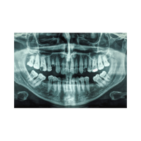
Issues #2: The exam is not reliable
  The exam misclassifies at least 20% of candidates who must retake the test, plus an unknown number who pass the test by luck and should not have been granted a license.
  The exam can by taken up to 3 times with no remediation or further training.
  It is impossible to standardize human subjects anatomically, physiologically, pathologically, and psychologically.
Notes:
The exam is not reliable. Clinical exams are impossible to standardize because no two humans are the same.
Dr. Chambers states: “When a measure is reliable, that means there is agreement on what the results are... A reliable test will give similar people similar scores. A reliable practical examination will be scored similarly by different people at different times.”
One area of unreliability in the current clinical licensure exams is in the variation found in pass rates. Damiano et al. looked at pass rates over a 10-year period from 1979-1988 and found statistically significant variability. The results indicated “the average percentage passing the exam ranged from 50 percent in Alaska to 97 percent in Alabama.”
In 2003, Ranney et al. showed a 31.25% failure rate at the University of Maryland School of Dentistry. When failure rates this high occur, the scoring of the exam should be called into question.
The current one-shot licensure exam misclassifies at least 20% of candidates who must retake the test, plus an unknown number who pass the test by luck who should not have been granted a license. If one out of every five dentists is misclassified due to poor reliability, with an unknown number receiving their license when they are not ready, the one-shot human subject, clinical licensure exam is flawed.
Candidates who fail the examination, whether due to misclassification or sub-standard work, are then permitted to take it again up to 3 times with no remediation or further training. If candidates are not required to receive further training after failing a licensure examination, they either continue providing substandard care to patients until they get it right or they pass the exam the next time they take it due to the lack of validity and reliability of the exam. Both scenarios present concerns when it comes to the patient’s safety.
Standardization is another aspect of reliability. Despite the fact that each candidate performs similar procedures on human subjects, no two humans are identical, therefore each clinical licensure examination is different. Variations inevitably are encountered, and standardizing human subjects anatomically, physiologically, pathologically and psychologically is impossible

Slide 6
Issues #3: The exam tests a narrow scope of practice
  With such a narrow scope of procedures tested, the current system is unreliable in determining whether a new dentist is truly competent to practice dentistry. It is not reflective of contemporary practice
  New graduates will be responsible for comprehensive care including, but not limited to:
  Restorative dentistry
  Periodontics
  Diagnosis and treatment planning
  Endodontics
  Prosthodontics
  Oral surgery
  Orthodontics
  Pathology
  Implantology
  Pharmacology
  Case management
  Proper relationships with patients
Notes:
The patient-based exam does not test all areas in which dentists should be knowledgeable.
With such a narrow scope of procedures tested, the current system is unreliable in determining whether a new dentist is truly competent to practice dentistry, and is not reflective of contemporary practice.
The dental school curriculum, which must conform to the standards set by CODA, is robust and thorough. The breadth and depth of the education is continually scrutinized and modified to ensure that new dentists have the knowledge and skills to practice to the standard of care in each and every discipline of dentistry. According to Dr. Ken Kalkwarf, past president of the American College of Dentists, “In their quest to improve reliability, they [the regional testing agencies] have narrowed the scope of their evaluation and have… evolved the assessment of care provided to patients…to an extremely narrow range of procedures to restore teeth and remove calculus.” He continues on to state “that this pursuit of reliability has negatively impacted the validity…of today’s exam.”
Upon gaining a dental license, new graduates will be responsible for the comprehensive care of the patients within their practice. They will be expected to perform, or at least be knowledgeable in, the complex disciplines of: restorative dentistry, periodontics, diagnosis and treatment planning, endodontics, prosthodontics, oral surgery, orthodontics, pathology, implantology, pharmacology, case management and proper relationships with patients.

Slide 7

Issue #4: The exam does not put the best interests of the patients first
  19.3% of dental students aware of classmates who prematurely treated a lesion for exam purposes
  8% knew classmates who purposefully created a lesion for the exam
  13.7% of dental students knew instances where patient was coerced into treatment choice that would otherwise have not been recommended
  23.9% neglected to make arrangements for necessary follow-up care
Notes:
Inhumane treatment: The exam does not put the best interests of the patient first
Question: Is it ethical to use human subjects for the purpose of discovering incompetence?
Each time a candidate fails a clinical licensure examination on a patient, that patient is potentially left with a restoration or periodontal condition that is below the standard of care. Failures in restorative procedures typically mean that the patient has had irreversible harm rendered to them. How can dentists and health care providers justify an exam that carries the potential for corruption and may not always have the patient’s best interests in mind?
In a study regarding ethical lapses on licensure exams, Feil et. al. reported that 19.3% of students were aware of classmates who prematurely treated a lesion for exam purposes; 8% reported knowing classmates who purposefully created a lesion for the exam; 32.5% reported knowledge of unnecessary radiographs; 13.7% reported knowledge of instances where a patient was coerced into a treatment choice that would have otherwise not been recommended; 23.9% reported they had neglected to make arrangements for follow-up care despite that it was necessary.
Candidates may perform the following questionable practices in order to meet the requirements of having a qualified board patient.
Complete multiple x-rays of individuals who will not become patients or be given comprehensive care.
Purposefully create a lesion for the exam.
Save a board lesion for the exam rather than treat it in the appropriate sequence of care.
Recommend an irreversible procedure for a tooth when remineralization could be the more appropriate treatment.
Treat lesion first for board exam prior to addressing more urgent dental care needs.
Each time a candidate fails a clinical licensure exam on a patient, the patient is potentially left with a restoration or periodontal condition that is below the standard of care. Failures in restorative procedures typically mean that the patient has had irreversible harm rendered to them.

Slide 8
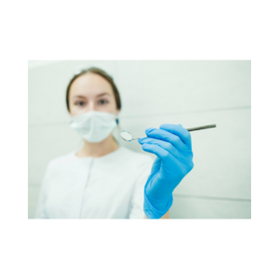
Issue #5: The exam needlessly places candidates in positions of moral distress
  Candidates may fail due to factors outside of their control
  Patients are treated as a commodity, and are often paid, purchased, sold, or traded when a candidate can’t find a patient who qualifies
  Businesses have formed that provide patients at a premium cost
Notes:
Candidates may fail the exam due to factors outside their control. Examples: failures due to patients not showing up, patients with elevated blood pressure, patient presenting for treatment under the influence of alcohol or other substances.
Paying patients or offering bonuses to ensure their patient arrives for their appointment on exam day.
Utilizing patient procurement services like Lu Lau Dental and Western Dental Consultants that can provide students with board exam patients for a large sum of money.

Slide 9
Licensure Reform: ASDA’s ideal exam
ASDA believes an ideal licensure exam:
  Does not use human subjects in a live clinical testing scenario
  Is psychometrically valid and reliable in its assessment
  Is reflective of the scope of current dental practice
  Is universally accepted
Notes:
Licensure can be a complex topic. ASDA’s L-1 policy outlines these ideals: https://www.asdanet.org/about-asda/leaders-and-governance/current-statements-of-position-or-policy/licensure/L-1
Does not use human subject - perhaps the most controversial issue with the current dental licensure exam process is that it is performed on a live human subject. Testing on a human opens poses various ethical, reliability and validity concerns. These high-stakes, one-shot testing scenarios on human subjects must end.
Psychometrically valid and reliable – Humans are unique. Administering an exam on human subjects means the student taking the test is experiencing a different test than other students.
The current exam is not reflective of the broad set of skills a dentist is required to be knowledgeable of when practicing
The current exam is state-driven, meaning each state determines the requirements for receiving a license in that state. Additionally, most dental licenses are only valid in the state in which you became licensed. For example: receiving your license in Washington does not necessarily mean you can practice dentistry in Michigan as well.

Slide 10
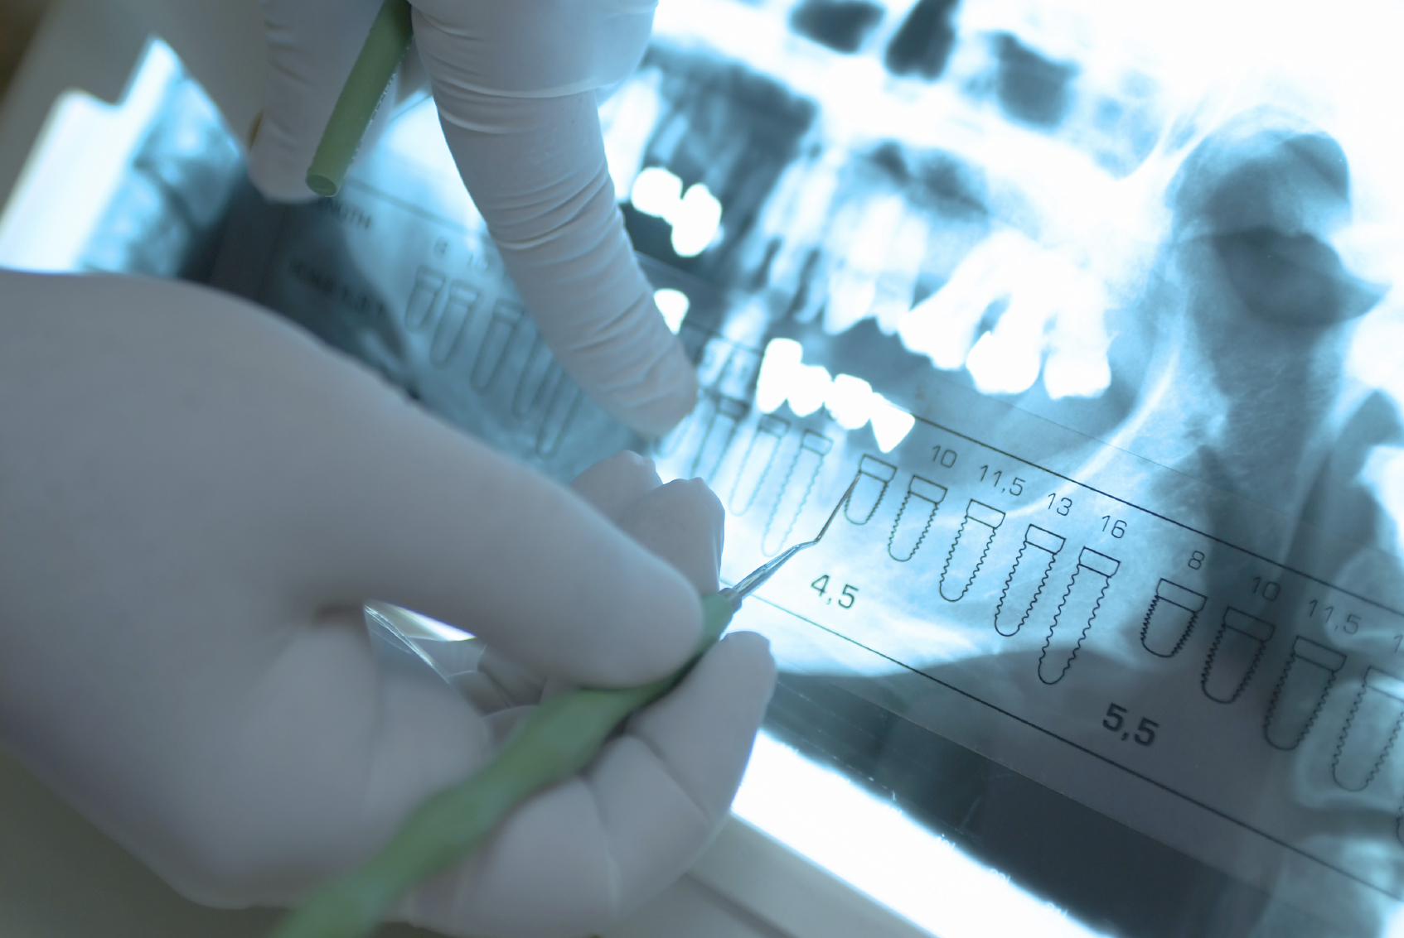
Licensure Reform: ASDA’s recommendation
ASDA believes kinesthetic and clinical decision-making competence should be demonstrated through:
  Manikin-based kinesthetic assessment and
  A non-patient based Objective Structured Clinical Examination (OSCE)
Notes:
An examination with these components would ensure competency in a greater breadth and depth of skills than any currently implemented or proposed method of initial clinical licensure. The OSCE has been shown to have psychometric validity.

Slide 11
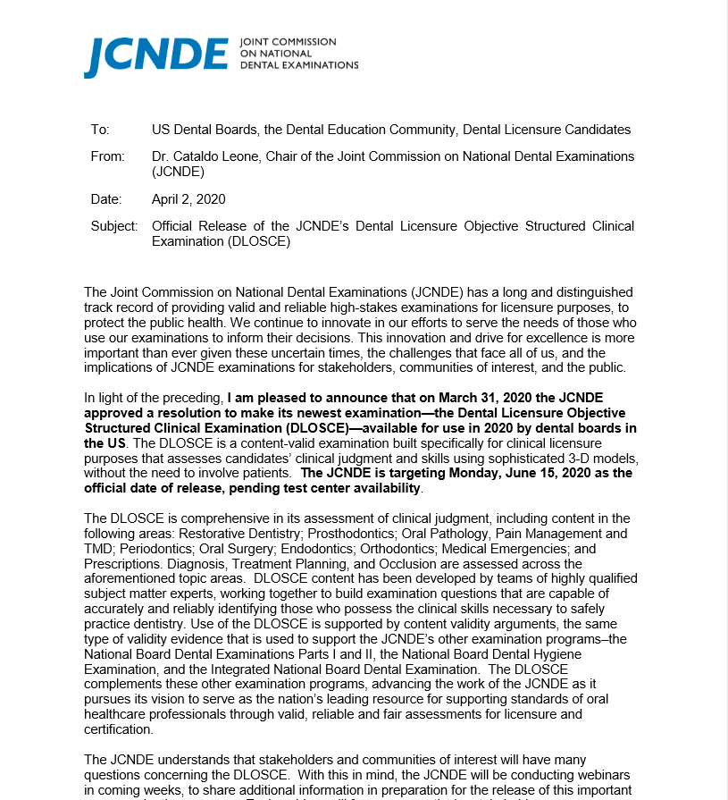
Licensure Reform: Available alternatives
Changes in the licensure process during the COVID-19 pandemic:
  All regional testing agencies released manikin-based assessments
  The ADA’s DLOSCE (Dental Licensure Objective Structured Clinical Examination) was released a year ahead of schedule
  Graduating students could apply for a temporary or provisional license
Notes:
After decades of advocacy, ASDA saw rapid momentum for licensure reform during the COVID-19 pandemic. Students successfully proved to state boards and testing agencies that a live human subject is not necessary to demonstrate competency.
On a state-by-state basis, any combination of the bullets above were accepted for 2020 and 2021
For the most up-to-date information, check ADA Dental Licensure Requirements Map: https://www.ada.org/resources/licensure/dental-licensure-by-state-map

Slide 12



Testing agencies
  Central Regional Dental Testing Service (CRDTS)
  CDCA-WREB-CITA
  Southern Regional Testing Agency (SRTA)
Notes:
There are three testing agencies that administer clinical exams on manikins and live patients.
These testing agencies are regionally based throughout the US. Certain states accept certain exams based on geographic location.
As of August 1, 2022, CDCA-WREB and CITA merged to become CDCA-WREB-CITA. CDCA-WREB-CITA administers the ADEX exam.
Two states do not use the services of a clinical testing agency:
Delaware conducts its own practical clinical examination and requires other post graduate education or practice experience as defined by the Delaware licensure board.
New York requires a doctoral degree in dentistry, plus completion of a clinically-based postdoctoral general practice or specialty dental residency program, of at least one year's duration, in a hospital or dental facility.

Slide 13
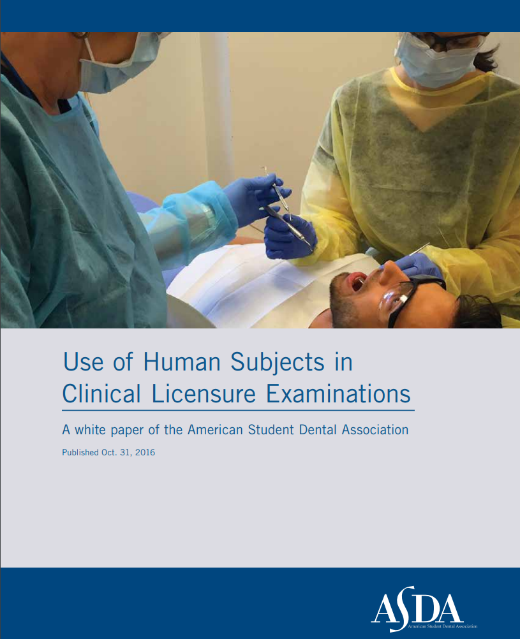
Licensure Reform: ASDA’s efforts
ASDA’s 2016 White Paper on licensure reform addresses concerns with validity, reliability and ethics
ASDA is a founding member of the Coalition for Modernizing Dental Licensure (CMDL).
In 2020, ASDA appointed a Licensure Task Force to lead the charge for permanent licensure reform.
Developed resources like the Licensure 101 flyer and PowerPoint presentation
Notes:
In 2016, ASDA published a white paper detailing the major shortfalls of the current licensure examination process. (Access the white paper: http://www.asdanet.org/uploadedFiles/The_Issues/Licensure-White-Paper-10-31-16.pdf)
The mission of the CMDL is to ensure patient safety, increase access to care, and promote professional mobility by modernizing the dental licensure process.
ASDA’s 2020-21 Board of Trustees appointed the first Licensure Task Force to investigate strategies for licensure reform amid the COVID-19 pandemic. Strategies included a letter being sent to all 50 states’ (+DC and Puerto Rico) dental board urging the acceptance of alternatives to live-patient clinical examinations; State Licensure Liaisons were appointed on the local level to monitor licensure activities.

Slide 14
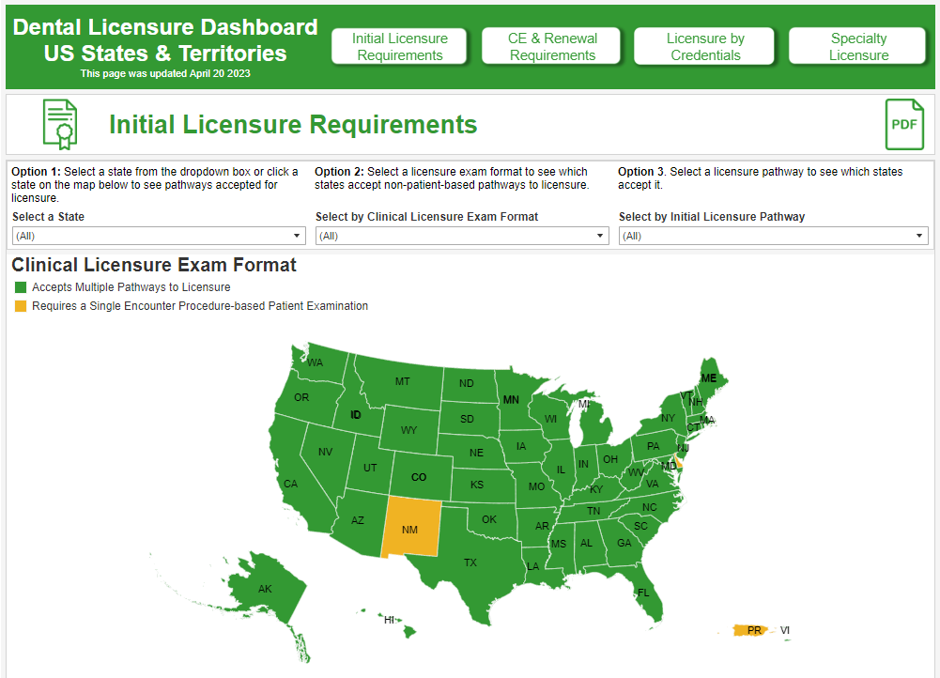
Licensure Reform: Current Status
For most current info, check:
  ADA’s Initial Licensure Requirements map
  ADEX Acceptance map
  Other testing agencies websites
  Your state dental board website
Notes:
Prior to 2020, only 10 states accepted non-patient based alternative exams. As of April 2023, nearly all states have moved to permanently accept many of the alternatives that they started accepting during the pandemic.
At least 48 states (including DC) now permanently accept a manikin exam as an alternative to the live-patient exam.
6 states accept the DLOSCE, the Dental Licensure Objective Structured Clinical Examination

Slide 15

ASDA advocacy: Next steps
  Sign up for ASDA Action text alerts
  Participate in Advocacy Month
  Read ASDA’s Advocacy Brief
  Send letters to Congress via ASDA Action
  Attend local advocacy events
  Participate in the Advocacy Certificate Program
Notes:
Encourage continued involvement in ASDA’s advocacy efforts.
ASDA Action text alerts:
Sign up for text alerts to stay on top of ASDA advocacy efforts.
Advocacy Month:
Make sure your chapter is hosting at least one event during Advocacy Month
Advocacy Brief
Stay up-to-date on important legislative and regulatory activities and political affairs related to dentistry.
Send letters via ASDA Action
Send letters, research bills, look up candidates or elected officials
Attend local advocacy events, ASDA national conferences
Advocacy sessions at national meetings
Advocacy Certificate Program
Participate in the program that acknowledges your advocacy contributions by earning points by participating in various advocacy initiatives (like attending this lunch & learn), sending ASDA Action letters, etc.

Slide 16
THANK YOU!
Questions? Contact
advocacydept@ASDAnet.org
Notes:
Contact advocacydept@ASDAnet.org with any questions

