Slide 1
The American Student Dental Association (ASDA)
Notes:
[Introduce the presentation and yourself.]
(For example, Thank you for joining us today to introduce you to ASDA and why membership in ASDA is an important step in getting connected to the field of dentistry. My name is xxxx. I’m a D2 at xxxx. I first became involved in ASDA xxxxx. After this presentation you will understand ASDA’s important initiatives and your member benefits. Let’s start.]

Slide 2
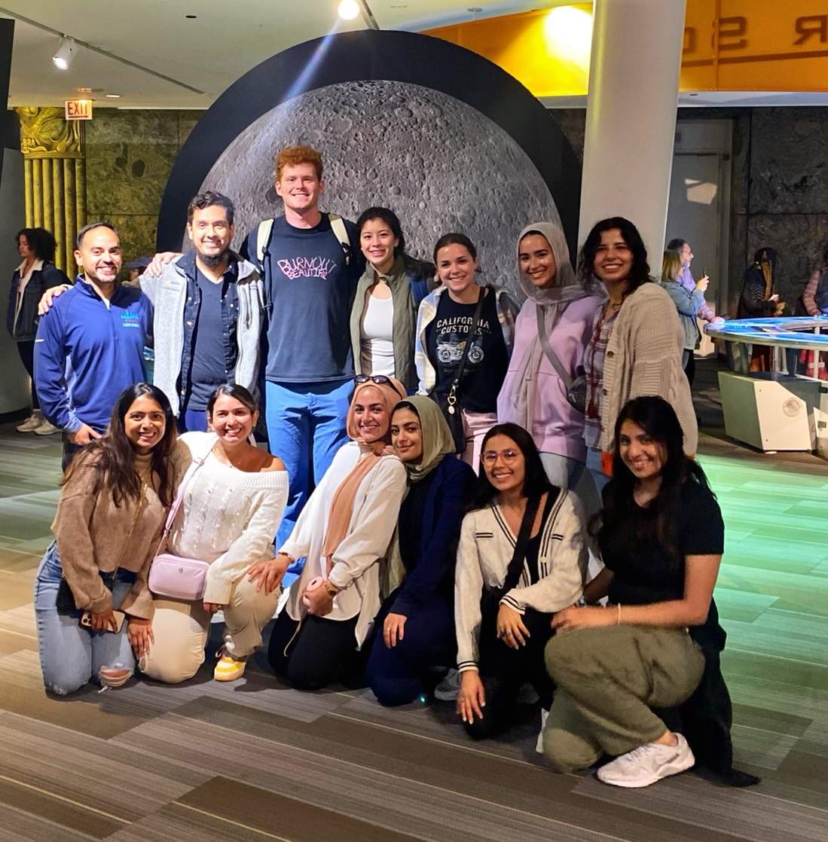
About ASDA
Founded in 1971
Largest student-run dental association
Over 22,000 total members
82% predoctoral market share
National ASDA
  11 Districts
  70 Chapters
Notes:
ASDA was founded in 1971 by dental students. Since the 70’s, ASDA has grown to become the largest national organization representing dental students. ASDA has a chapter at every dental school in the US and Puerto Rico, as well as a national office in Chicago. Let’s take a closer look at how ASDA is organized.

Slide 3
ASDA’s Mission
The American Student Dental Association is a national student-run organization that protects and advances the rights, interests and welfare of dental students.
It introduces students to lifelong involvement in organized dentistry and provides services, information, education, representation and advocacy.
Notes:
ASDA member leaders at the national, district and local level help fulfill ASDA’s mission. What is a mission? A mission is an explanation of why an organization exists.
What is ASDA’s mission:
ASDA is a national student-run organization that protects and advances the rights, interests and welfare of dental students. It introduces students to lifelong involvement in organized dentistry and provides services, information, education, representation and advocacy.
Our mission guides what ASDA does, who we do it for and how we do it. For ASDA, that means we are a student-run organization that:
Protects dental students
Advances dental student rights/interests
Introduces organized dentistry
Provides information and education
Represents dental students
Advocates on their behalf

Slide 4

Vision
To advance the dental profession by developing exemplary leaders and inspiring member advocacy.

Slide 5
What does Organized Dentistry mean?
Organized Dentistry
  Combined efforts of all dental organizations
ASDA partners with:
  American Dental Association (ADA)
  Academy of General Dentistry (AGD)
  American Dental Education Association (ADEA)
  State dental societies and associations
  Specialty societies and associations
  Student dental groups
Notes:
Organized dentistry is a way to describe the combined efforts of all dental organizations (such as ASDA, ADA, state societies, etc.) that work together to positively contribute to the dental profession.
ASDA fosters the path toward a lifelong commitment to organized dentistry both at the chapter, district and national level. ASDA works with other organizations to represent the dental student voice and make change.
Examples of collaboration include working with AGD, other specialty organizations and with student dental groups like SNDA, SAID, HSDA, and ADEA Council of Students.

Slide 6
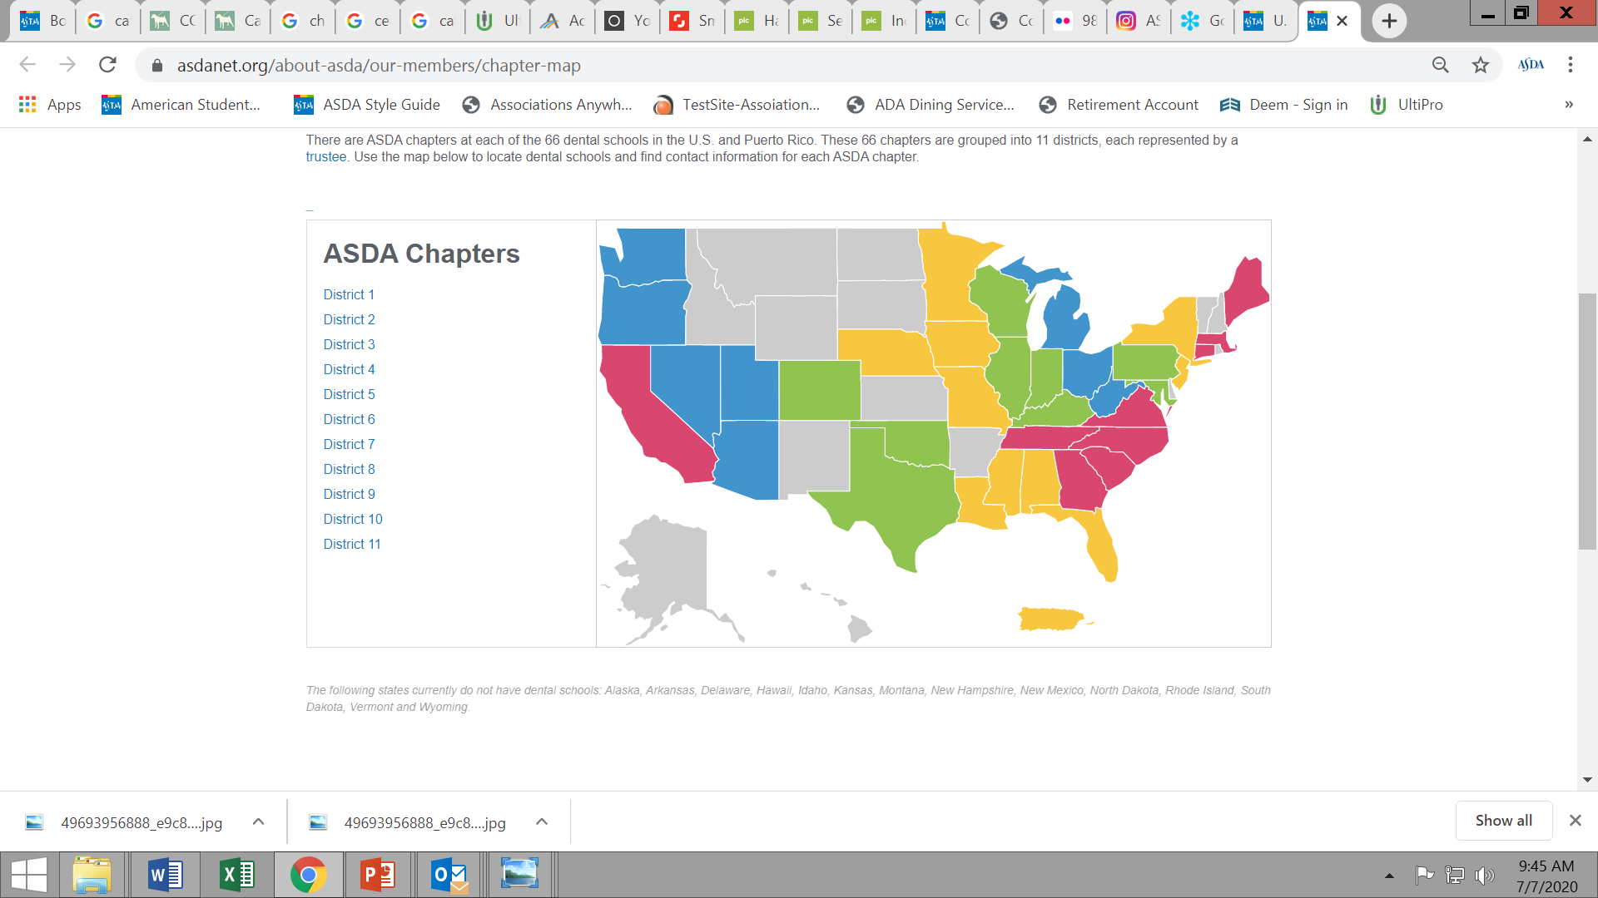
ASDA’s Structure
National
District
Chapter
Notes:
ASDA is comprised of three levels – national, district and chapter. It takes all three levels working together to make ASDA successful. Dental students are the focus of ASDA and help lead the organization.
Student members guide national ASDA through the Board of Trustees and the House of Delegates. National ASDA advocates on behalf of members, provides education, works with industry to offer member discounts, keeps you knowledgeable about organized dentistry and supports the districts and the chapters. National ASDA serves as a voice for all members.
ASDA’s Board of Trustees consists of the Executive Committee, 11 district trustees and the Immediate Past President.
Each dental school has an ASDA chapter. Each chapter has two representatives, also known as delegates, who vote during the House of Delegates. The House of Delegates votes on ASDA policy such as legislative policies, ASDA’s code of ethics, professional issues such as vaping and more. The House also elects ASDA’s president, two vice presidents and Speaker of the House, who are part of ASDA’s Executive Committee.
At the district level, student member leaders represent the interests of student members within their district. Chapters are grouped into one of ASDA’s 11 districts. The chapters of a district elect their ASDA District Trustee who sits on ASDA’s Board of Trustees.
Your ASDA chapter provides leadership, community and engagement at the local level.
To help support the House, Board and ASDA’s councils and committees, ASDA has a national office in Chicago with staff members. Staff work in areas such as membership, social media, advocacy and education- all focused on ASDA’s members. This structure is similar to the ADA. The ADA also has a House of Delegates, a Board of Trustees, national council and committees, and staff located in Chicago.

Slide 7
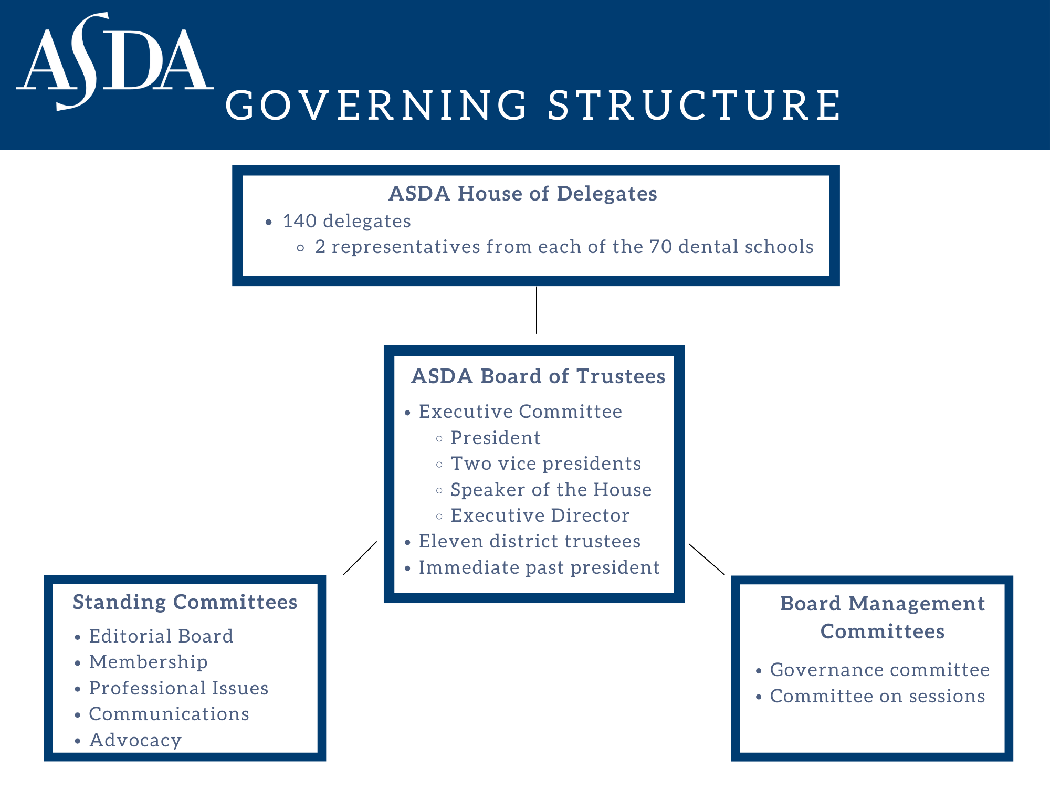
Notes:
This graphic shows the governing structure of ASDA. You can see the positions in the structure all of which are held by students.
[Have any chapter members serving at the national level speak about their experiences]

Slide 8








What does ASDA do?
Notes:
ASDA’s mission sets the objectives of the organization and informs what ASDA does. As a result of ASDA’s mission, we:
Are a channel for member concerns including dental education, ethics, dental research, dental school financing
Provide learning and education to help members lead in practice and within organized dentistry
Support diversity and inclusion
Capture support of legislators and dental schools through grassroots initiatives identified by members
Provide a dental student and organized dentistry community
Keep members up-to-date on issues important to dental students
Common thread – ASDA’s mission is focused on dental students. Dental students, who are members, set the course in identifying concerns, policies, legislative objectives, etc. ASDA exists for its members and its members, you, guide ASDA. So, what does it mean to be a member of ASDA?
[include what ASDA membership means to you]

Slide 9
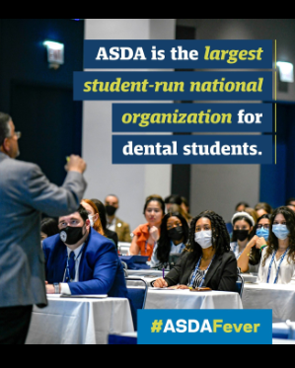
Your Member Benefits
Deals and Offers
Advocacy
Publications & Podcast
Education
National Programs and Events
Leadership Opportunities
Student Membership with the ADA
Notes:
As an ASDA predoctoral member, you’ll gain access to member benefits that help you succeed in school and in your career. ASDA membership includes:
Student membership in the ADA. Predoctoral and international dental student members of ASDA also become student members of the ADA and are eligible for the same benefits as dentists
Access to legislators to influence and educate them about dental care, delivery modes, licensure and reimbursement policies
Free subscription to ASDA’s award-winning publications
Education on Wellness, Advocacy, Career Resources and Clinical & Cutting-Edge topics
Interactive experiences with seasoned dental professionals and dental students at chapter, district and national ASDA events
Development of leadership and interpersonal skills which you’ll need when you begin practicing
Discounts and financial benefits and savings including life & disability insurance and malpractice insurance
These benefits offer you opportunities to get involved and create a community and a connection to your peers through ASDA at the chapter, district and national level. Let’s dive deeper into these areas.

Slide 10
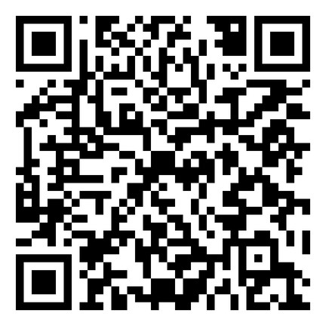
Deals & Offers
Apparel
Insurance
School Supplies and Shipping
Test Prep and Learning Resources
Notes:
Use your ASDA membership to get a discount! ASDA has collaborated with businesses and organizations to offer our members discounts and deals to make life a little more affordable while in dental school. We’ve got some great deals for you. Scan the QR code to check out what’s available.

Slide 11



Contour
A publication that keeps you updated on current issues in dentistry.
Notes:
You have access to ASDA’s award-winning magazine. It is a great resource on issues important to dental students. Articles are written by experts in the field, current dental students, and recent graduates. Article topics include wellness, leadership, advocacy, science and technology and more.
Editorial Board strives to have representation from every chapter in Contour.
[Highlight articles that you’ve found helpful or were written by a district or chapter member.]

Slide 12
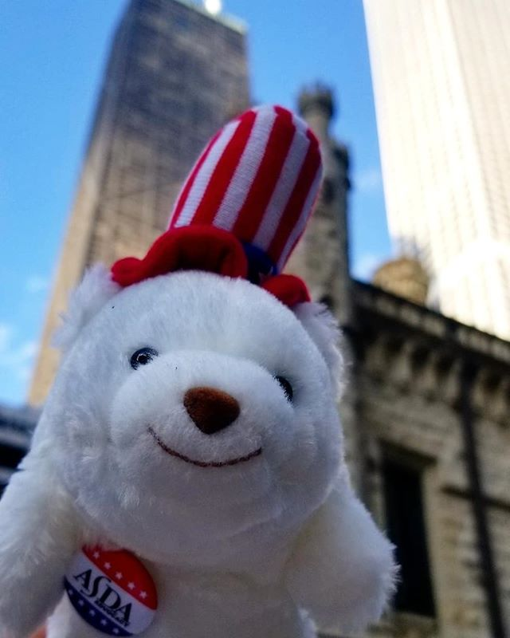
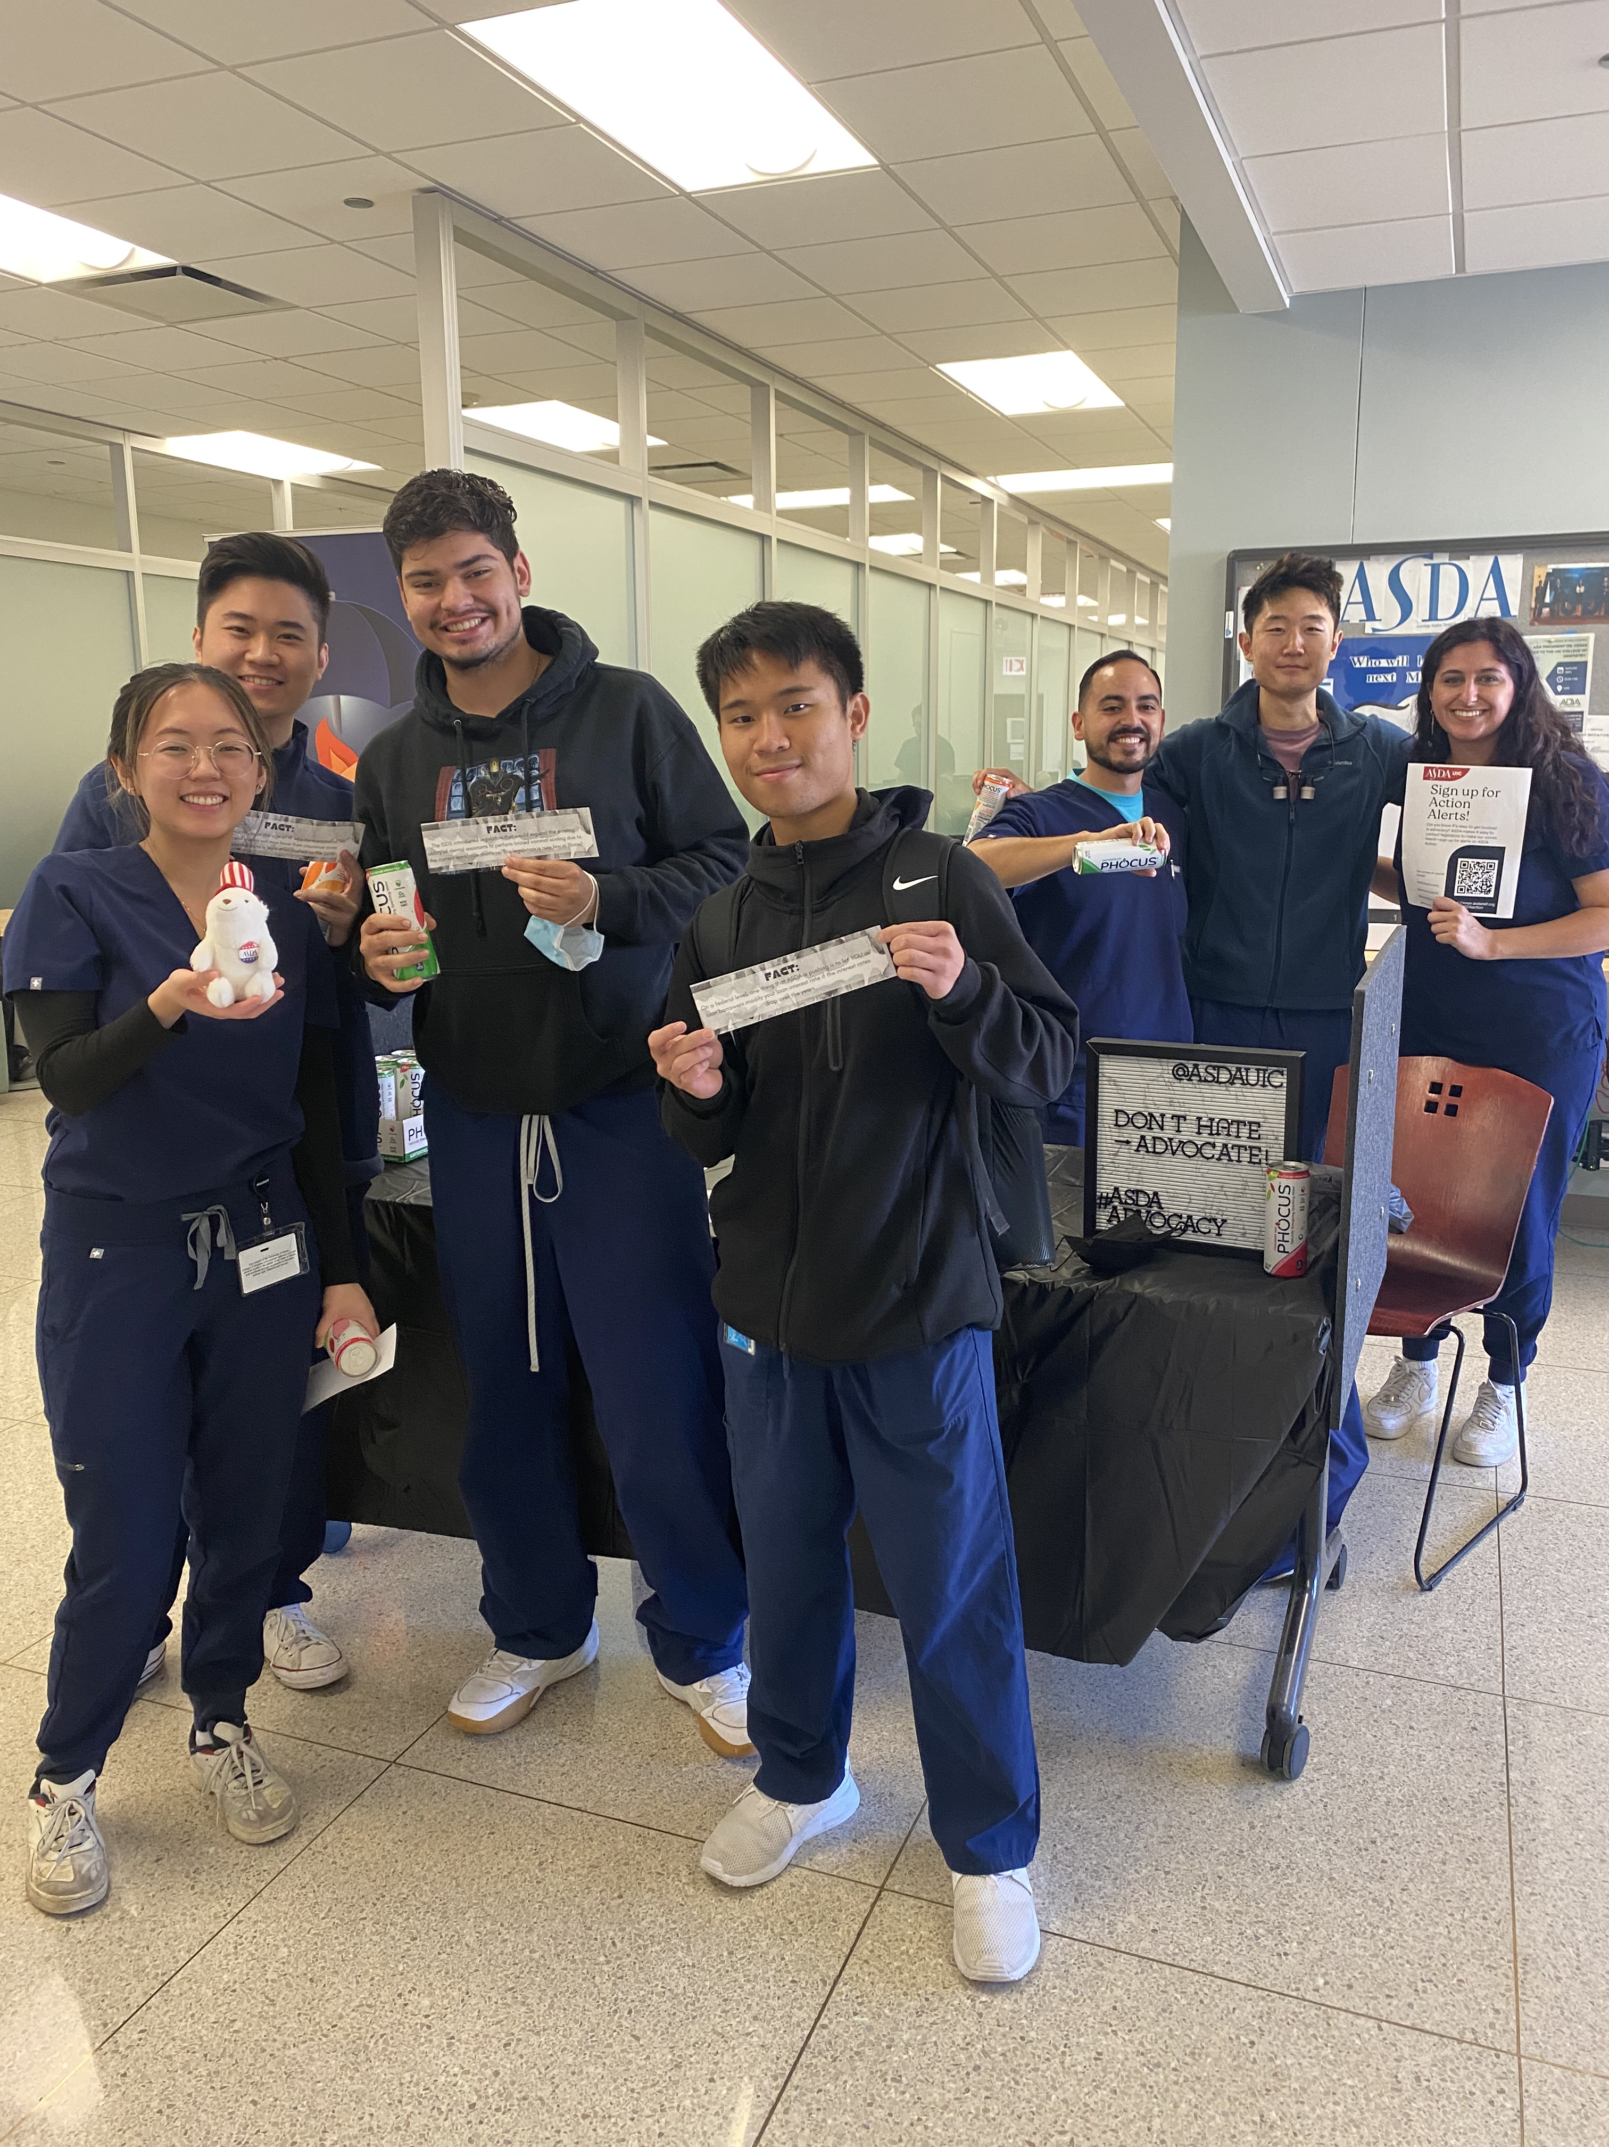
ASDA Advocates For You
Keeps you informed on issues impacting the dental profession
Represents your interests and provides opportunities to champion your rights as future dentists
Supports patients by advocating for the protection and advancement of their welfare within the profession
Notes:
Goals of ASDA advocacy:
Keep students informed – this is achieved through advocacy webinars and ASDA’s e-publication Advocacy Brief. Advocacy Brief shares updates on the state and federal level about issues that affect dental students, like licensure reform, midlevel providers, student debt, etc.
Provides opportunities to champion our rights and get involved– ASDA Action – send letters directly to lawmakers. Supports patients – support specific legislation to alleviate barriers to care and protect patients.

Slide 13
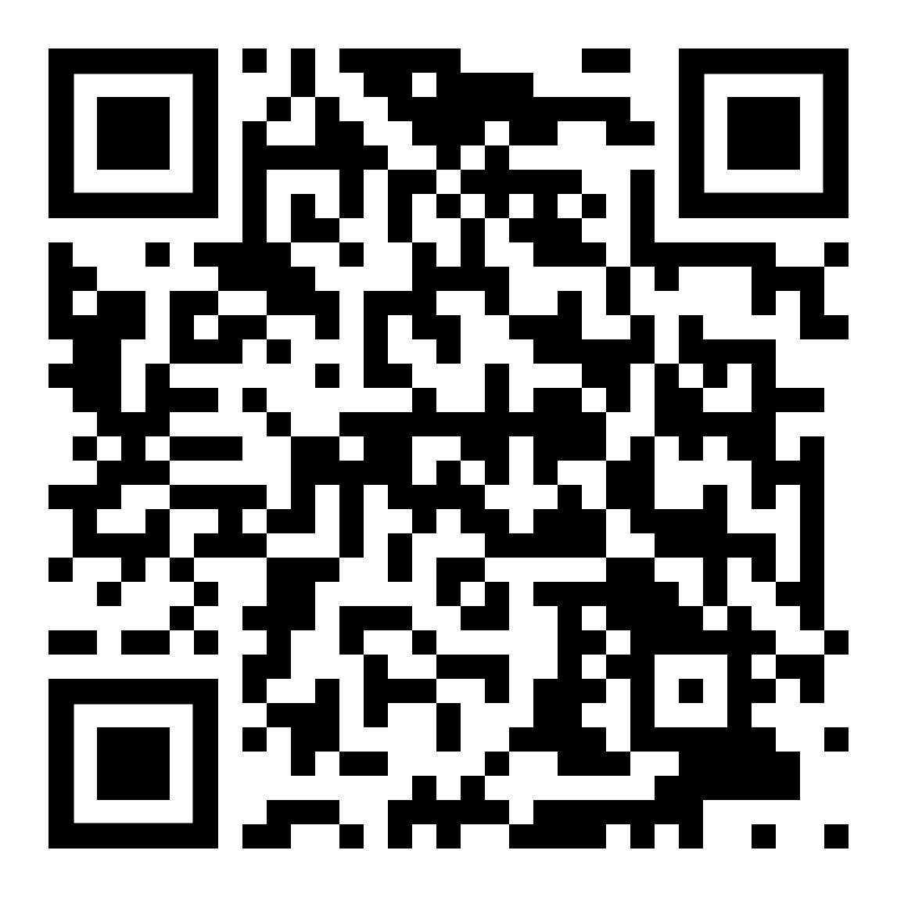
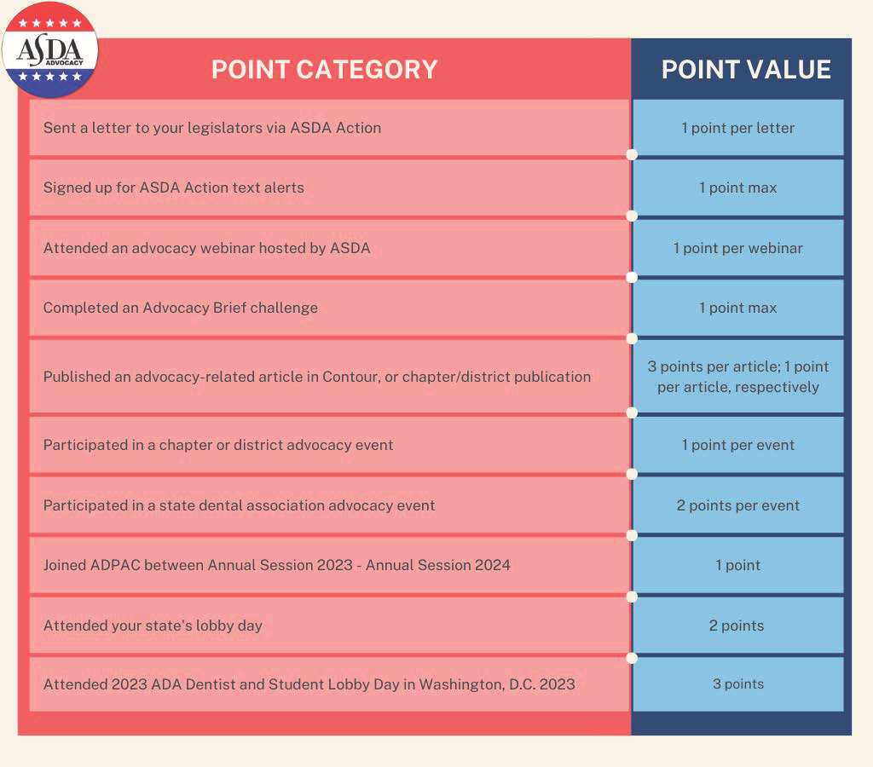


Easy Ways to Get Involved
  Advocacy Certificate Program
  Sixty Seconds to Advocacy
  Sign up for ASDA Action texts: scan the QR code to sign up!
Notes:
ASDA Action is your way to get involved with advocacy at the grassroots level. Grassroots advocacy means starting at the local level to affect change on a larger scale. It’s centered around the idea that people matter, your stories matter, and our voices are powerful in influencing elected officials at all levels. ASDA Action makes it simple, quick, and easy to get involved. You can
Send letters to your legislators on issues that affect dental students
Sign up for text alerts to receive a text when we need you to take action
ASDA continues to focus on licensure reform and student debt.

Slide 14
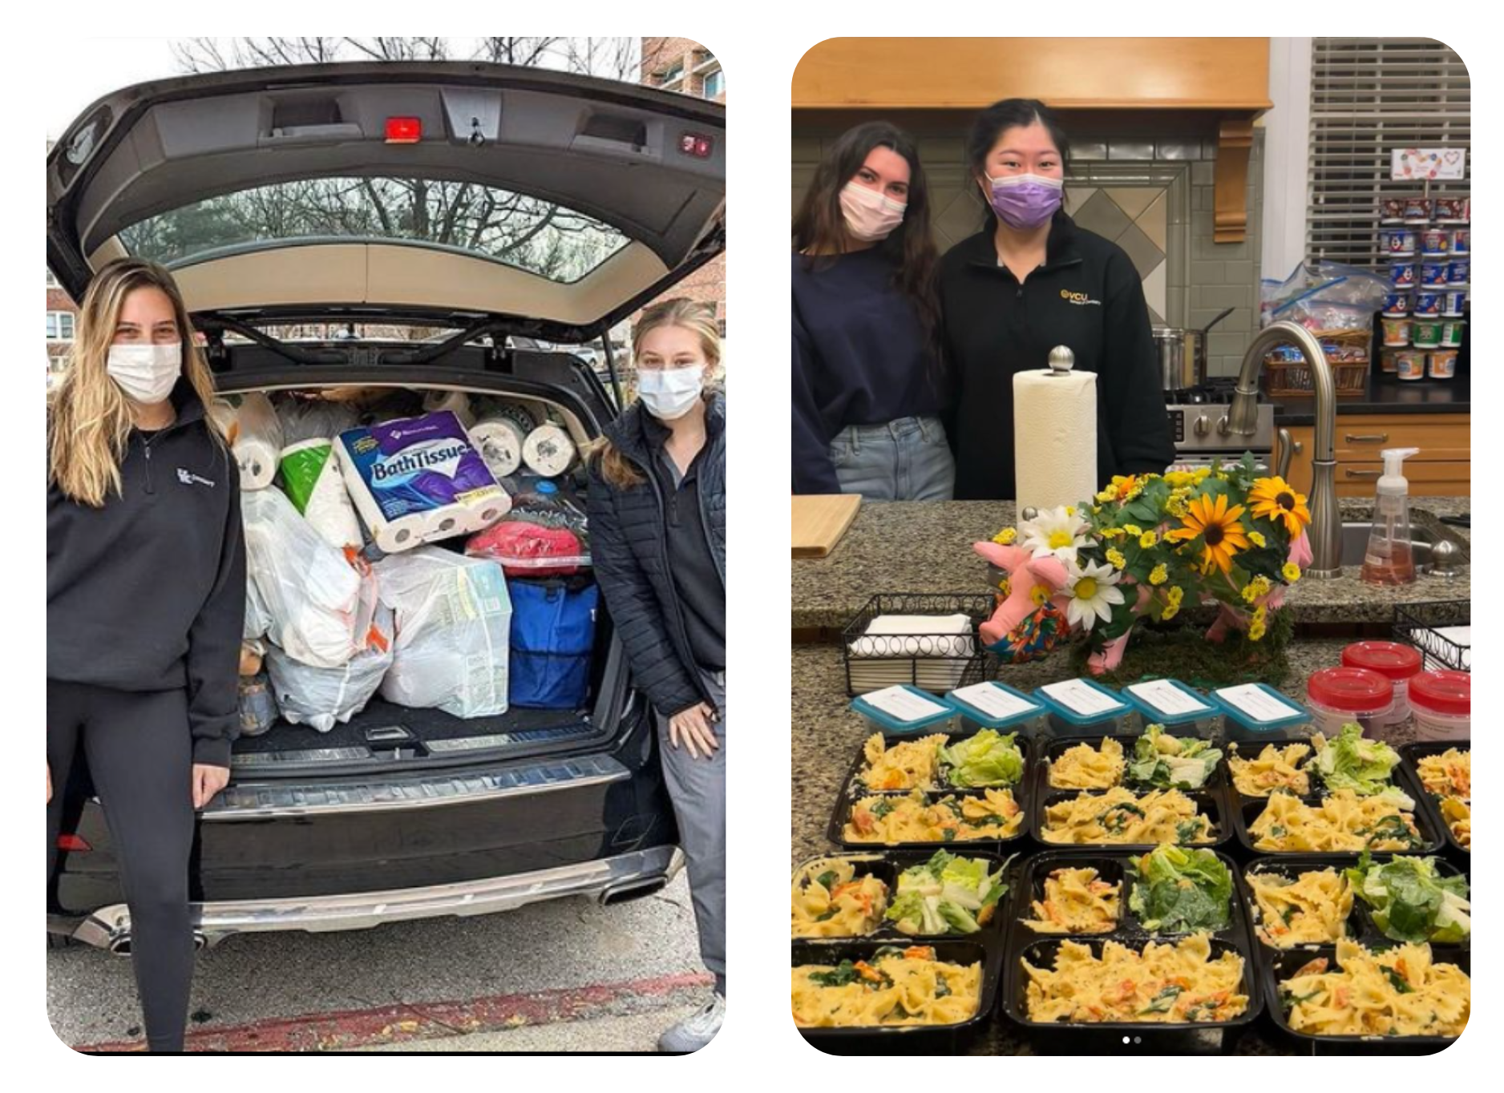
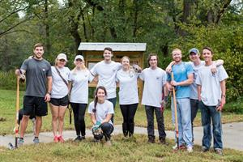
Serving Your Community
Notes:
ASDA is committed to community service and outreach. National ASDA encourages and supports chapter community service and outreach initiatives through an annual Service Month event. These events help meet the needs of the community. Community service benefits those receiving the service and those volunteering their time to support others. It is a time to step back from other commitments and bring people closer together.
Community outreach involves providing professional services, or services of a specific expertise, to a group of people who may not otherwise have access to those services. It is performed where those in need are located. (Example: providing dental services or education at a homeless shelter.)
Community service is work done for the benefit of the local community overall. Community service can be completed remotely. (Examples: hosting a clothing drive on campus, cleaning up trash from a park or beach.)

Slide 15

Diversity and Inclusion
Cultivating a welcoming environment for students. Identify barriers to involvement for underrepresented students, educate members and work to eliminate them.
Notes:
MISSION IS NOTED ON SLIDE
Developed national programming to offer resources to members on diversity and inclusion. Resources include webinars, how to guides, and conference programming.
Developed a Diversity & Inclusion Week to ensure DEI efforts remain a priority for the organization. In 2022, the week focused on educating our members on D&I concepts. The 2023 D& I week focused on highlighting the great work being done locally by chapters and individuals.

Slide 16

ASDA Cares About Your Wellness
Notes:
ASDA’s Wellness Initiative focuses on five of the commonly accepted dimensions of wellness: emotional, physical, intellectual, occupational and environmental.
The goals of the initiative are to:
Make information on overall wellness available to keep the issue top of mind for our student members
Educate members about the different dimensions of wellness and how to find a balanced way to address all of them
Encourage member participation in individual and group wellness activities, like wellness challenges
Wellness month is each September. In 2023 the theme was Finding Joy. No matter the theme there are always a variety of ways to participate in Wellness Month at the chapter and individual level.

Slide 17


ASDA Meetings: National
National Leadership Conference
Build leadership skills that benefit students throughout their dental careers.
Each fall in Chicago
Annual Session
ASDA governance, policy & elections, chapter leader training
Each winter in locations around the country.
Notes:
National ASDA meetings include:
National Leadership Conference
Bridges the educational gap between the clinical skills taught in dental school and the soft skills and knowledge needed to be a successful dental team leader, manager or practice owner that are often left out of dental school curriculum. Content focuses on 5 core areas: leadership, career planning, advocacy, personal development and wellness, and clinical practice management.
Annual Session
Brings together student leaders from all ASDA chapters for chapter leader training and idea sharing opportunities. Serves as the official meeting of the ASDA House of Delegates to debate and vote on policy and elect the Executive Committee. Elections for the Board of Trustees also occurs.
[Add your personal experiences at these meetings]

Slide 18

ASDA Leadership in Action
Notes:
Another key focus for ASDA is leadership development. As future dentists, you will be oral health leaders and ASDA is your path to gaining skills beyond those learned in dental school.
[Share your experience as an ASDA leader, what got you started and why fellow students should get involved.]

Slide 19
Become Engaged!
Leadership Opportunities
  [Provide Info]
Volunteer Opportunities
  [Provide Info]
Upcoming Events
  [Provide Info]
Notes:
[For both recruited and auto enroll programs, review ways members can become engaged with the chapter. Highlight different opportunities for members to get engaged including leadership opportunities, volunteer opportunities and upcoming events. Include photos of chapter events.]
[Include your chapter social media here.]

Slide 20
Your District
Communicates national ASDA strategic goals, initiatives, resources and news
Executes a district meeting
Fosters inter-chapter communication and events
Notes:
Add District logo, Instagram, and other social information. Include any upcoming district events, initiatives, etc.

Slide 21

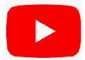


Get Connected with National ASDA
Instagram
    @dentalstudents
YouTube
    ASDAnet
Website
    ASDAnet.org
Email
    membership@asdanet.org
Notes:
Get connected to ASDA on social media to stay up-to-date on all that is going on and build your dental community. Make sure you’re following us on Instagram at @dentalstudents, bookmark the website asdanet.org and note our general email address membership@asdanet.org

Slide 22
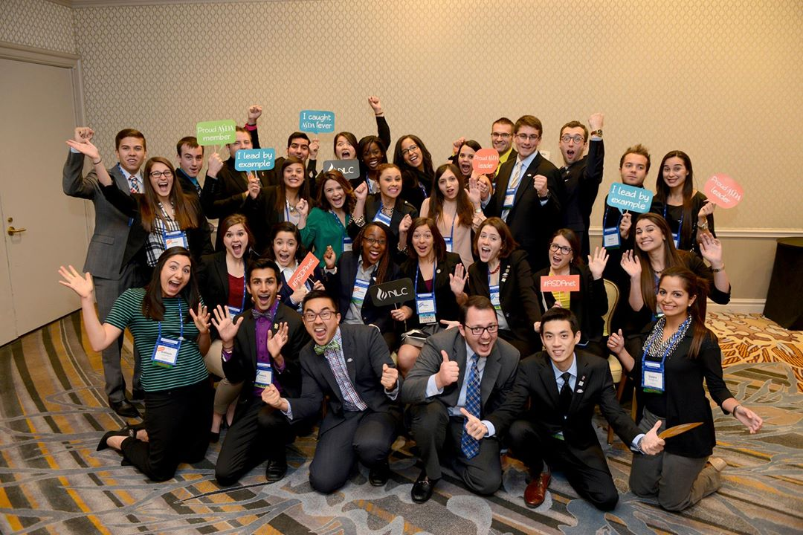
How to Join
Dues are $97/year
  Talk with your chapter about joining for membership through December 31, 2025.
  $5 of the $97 goes to the ADA, as predoctoral ASDA members are also members of the ADA.
Notes:
[2025 opens September 4, 2024.]
[If your chapter has a specific process for collecting membership dues, update slide as needed.]
[For auto enroll chapters explain the process used for your school]
[For recruited chapters explain how to join, through ASDA website, send information to membership rep, sign up on site]
[All Chapters]
ASDA is an organization focused on dental students. We are able to achieve our mission through the support of our members.
As a reminder, all predoctoral ASDA members are student members of the American Dental Association. As a predoctoral member of ASDA, you receive your ADA ID number which will be your number throughout your professional career. $5 of ASDA dues goes to the ADA. Learn more about getting involved in ASDA and the benefits of membership through the link.

Slide 23

Notes:
As you’ve heard throughout this presentation there are many ways that you can get involved with ASDA. We have a place for you. Whatever your interest, you'll find ways to put it into action. Our chapter is here to support you. Throughout your ASDA experience you will continue to see programming in community service, wellness, advocacy and leadership and you will be able to get involved through our chapter and national ASDA opportunities.

Slide 24
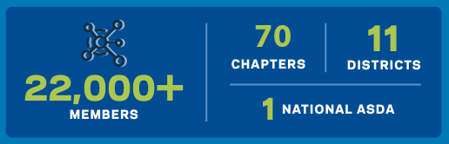
ASDA IS
Notes:
ASDA is 22,000 plus members, 70 chapters, 11 districts, 1 national ASDA.

Slide 25



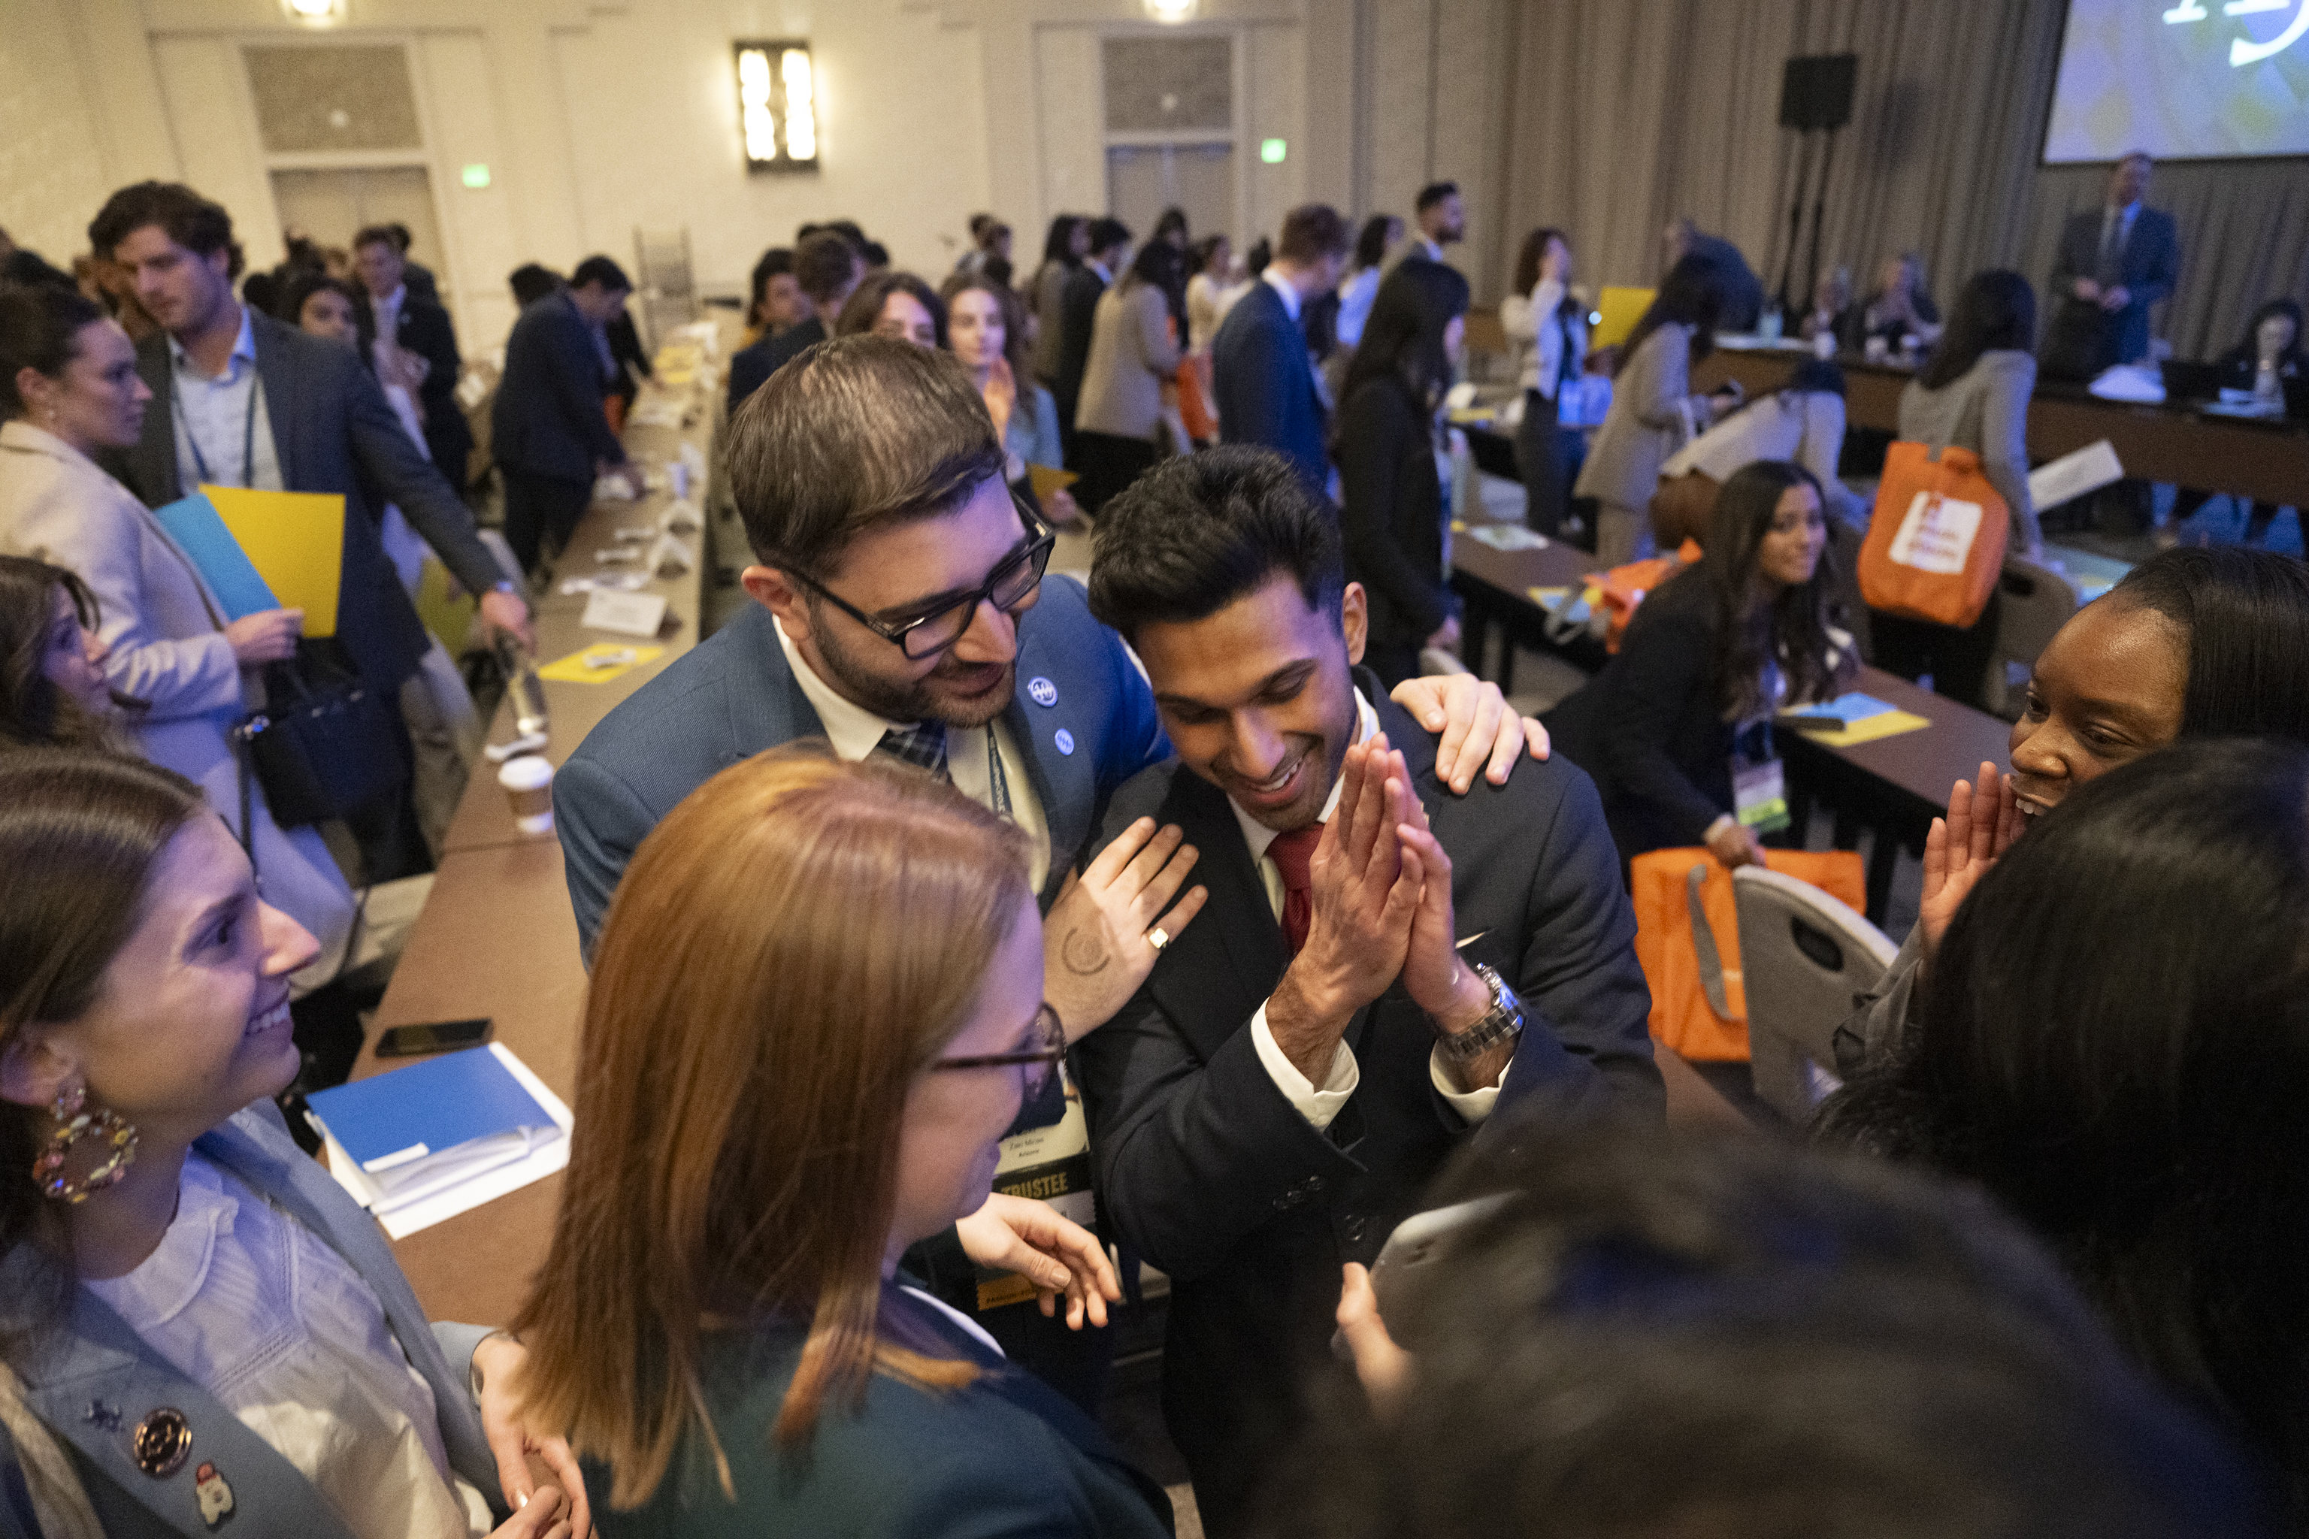
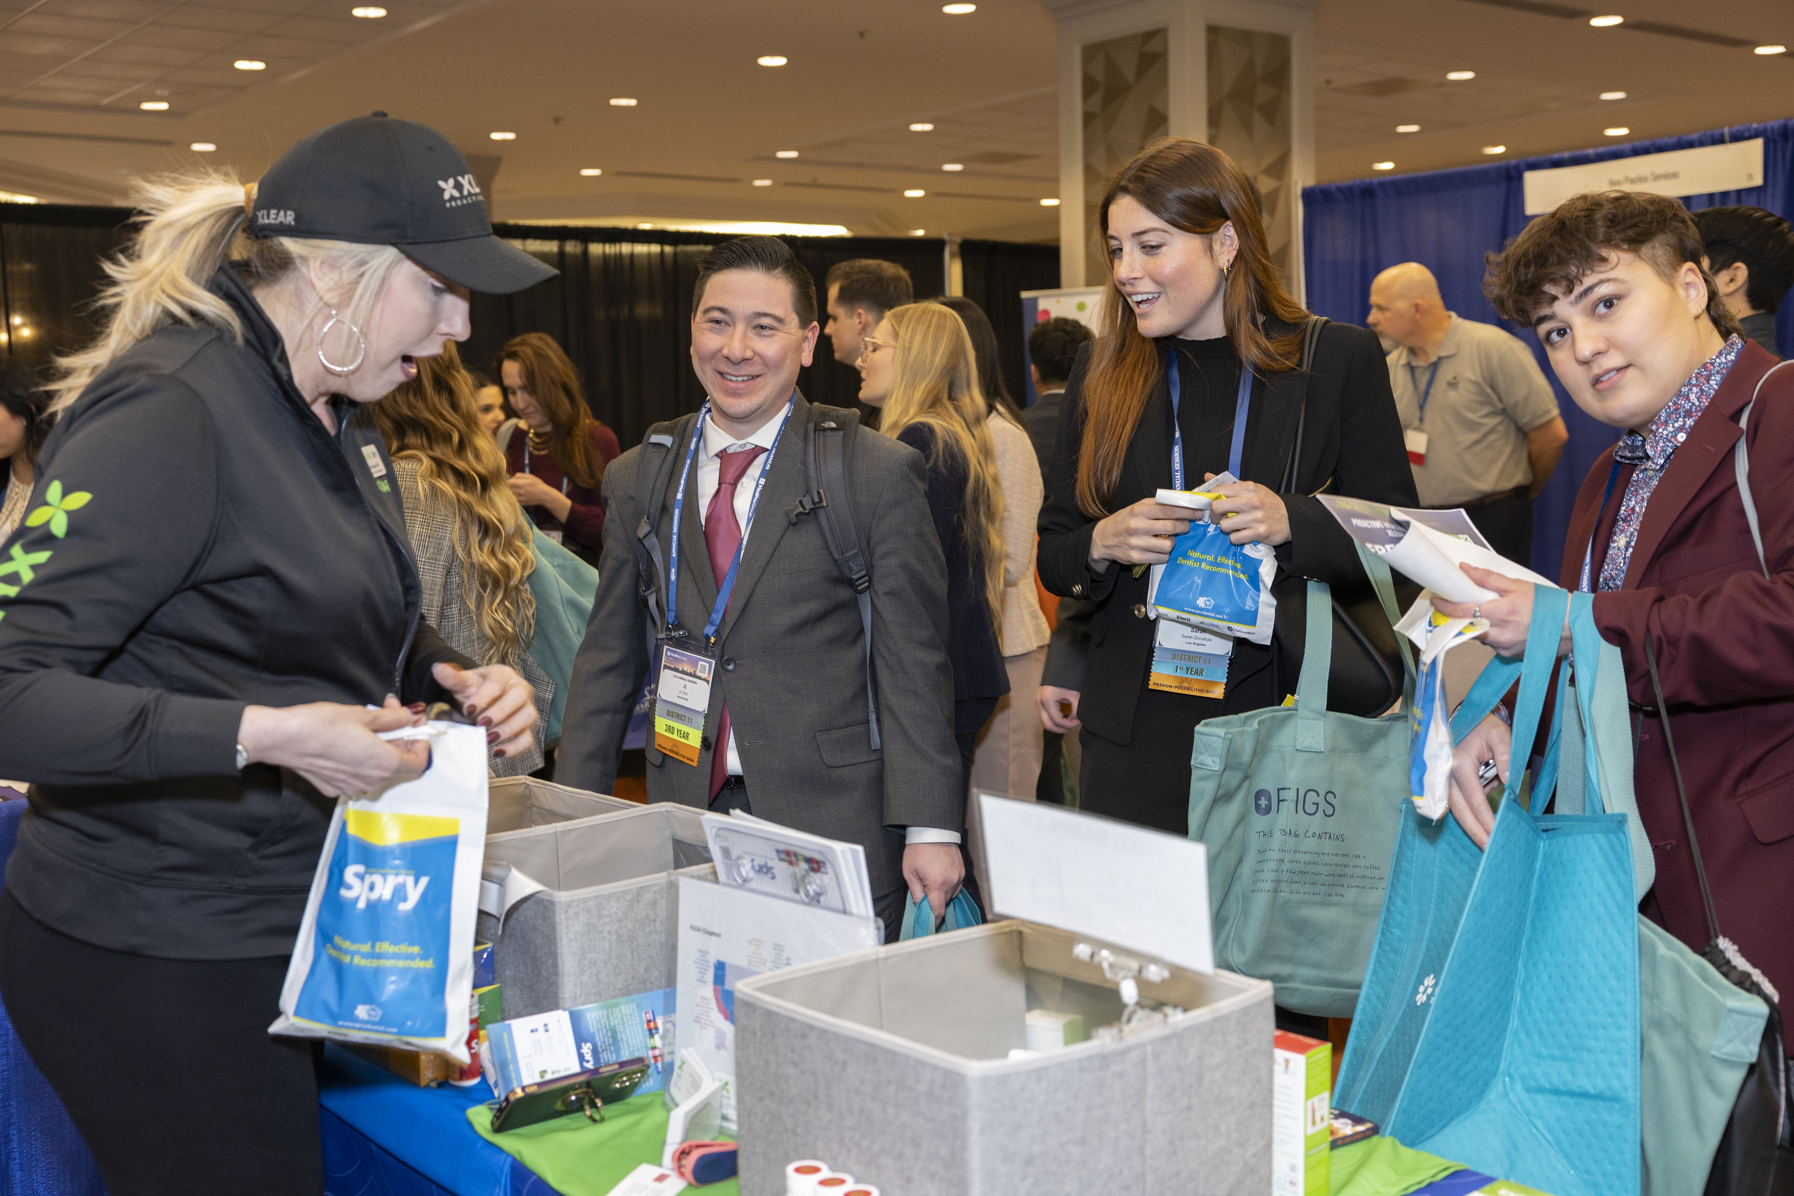
ASDA is YOU!
Notes:
[Update with pictures of your members.]
Getting involved in our ASDA chapter provides you a voice within ASDA to shape ASDA’s advocacy efforts and policy. It provides you leadership opportunities and support beyond what you learn as part of the dental school curriculum to help you gain the skills you need to be a leader in the profession. It connects you to the larger community within ASDA and organized dentistry. And, ASDA keeps you up-date.
ASDA’s mission is focused on dental students. Dental students, who are members, set the course in identifying concerns, policies, legislative objectives, etc. ASDA exists for its members and its members, you, guide ASDA.
ASDA is YOU! Thank you!

