Slide 1

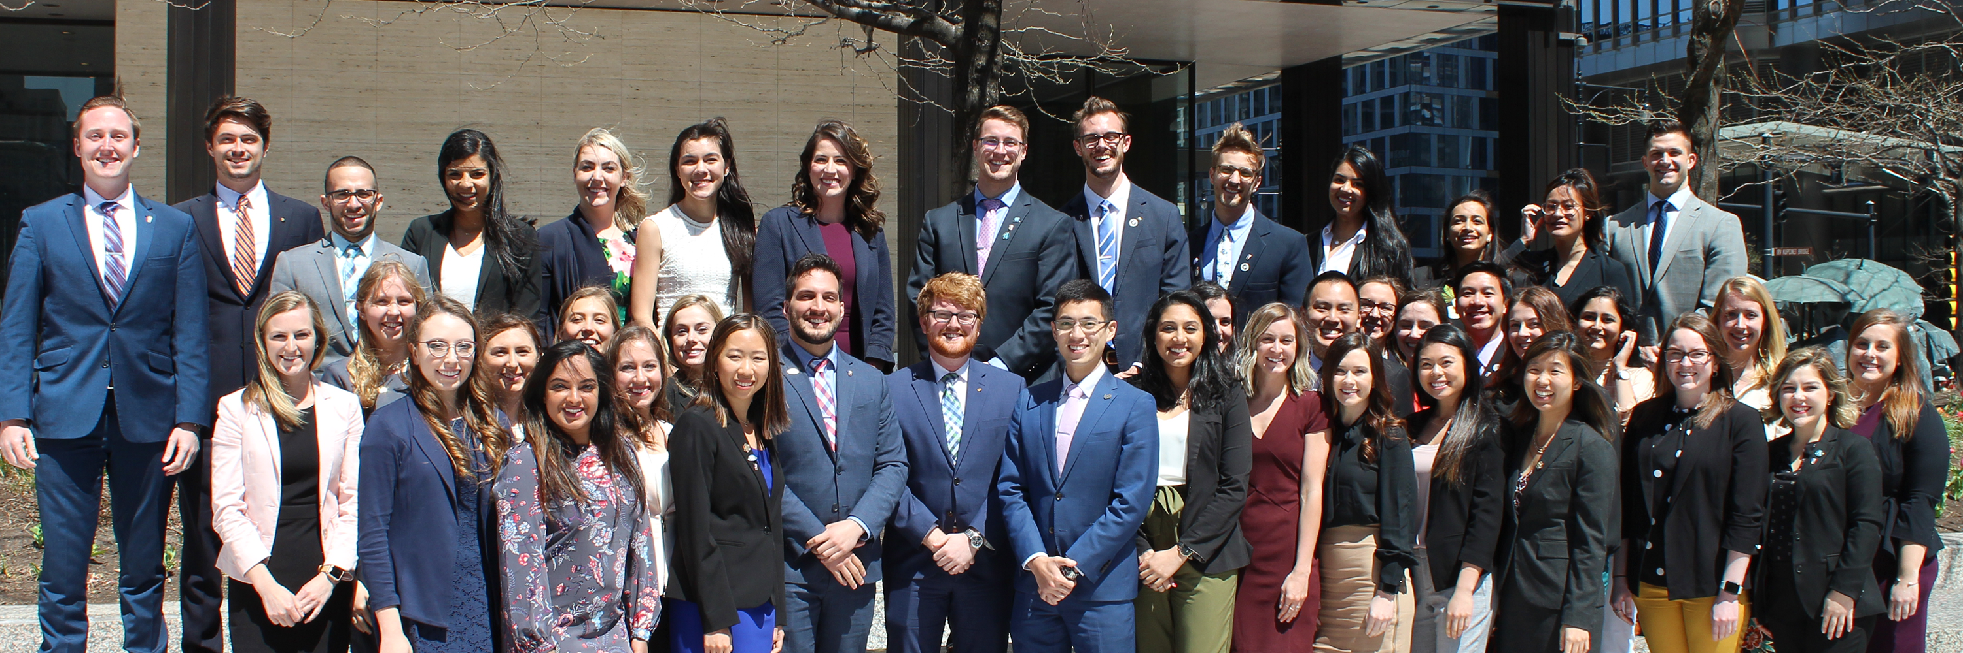
National Governing and Leadership Structure

Slide 2
What is ASDA?
The American Student Dental Association is a national student-run organization that protects and advances the rights, interests and welfare of dental students.
It introduces students to lifelong involvement in organized dentistry and provides services, information, education, representation and advocacy.
Notes:
2

Slide 3
Why Does ASDA’s Structure Matter to Leaders?
Provides the framework to carry out business of the association.
Shows leaders where to go for information.
Helps leaders become experts on all things ASDA and pursue their leadership path.

Slide 4
ASDA’s Governing Structure
ASDA House of Delegates
152 Delegates: two representatives from each of the 76 U.S. dental school
ASDA Board of Trustees
Executive Committee
  President
  Two vice presidents
  Executive director
  Speaker of the house
Immediate past president
13 district trustees
Standing Committees
Editorial Board
Membership
Professional Issues
Communications
Advocacy
Wellness
Board Management Committees
Governance Committee
Committee on Sessions
Notes:
4

Slide 5
Executive Committee
Oversees and administers the work of ASDA between Board of Trustees meetings
  Fulfills the directives of the house of delegates
  Reviews the budget and oversees fiscal planning
  Approves interim policy and procedures
Who makes up the Executive Committee?
  President
  Two vice presidents
  Speaker of the house
  Executive director
Elected by the ASDA house of delegates
Notes:
5

Slide 6
Board of Trustees
Oversees and administers the work of ASDA
  Fulfills directives of the House of Delegates
  Approves the budget
  Assigns work to ASDA’s councils and committees
  Appoints leaders
  Determines interim policy by 2/3 vote between House meetings
Who is the Board of Trustees, and how are they in position?
  Executive Committee: Elected by the House of Delegates
  Immediate Past President: Assumes role after presidential year
  District Trustees: Each trustee is elected by their individual (one of 13) districts
Notes:
6

Slide 7
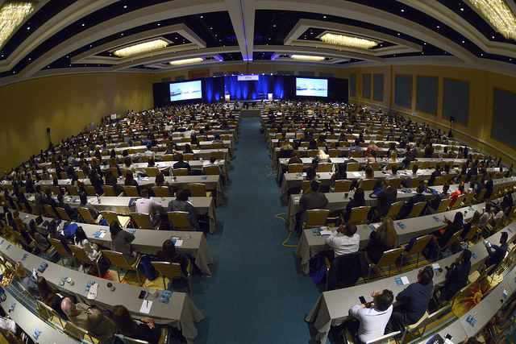
Who is ASDA’s House of Delegates?
152 Voting Delegates:
  Two delegates from each of ASDA’s 76 chapters get to vote.
Speaker of the House (non-voting)
Board of Trustees (non-voting)
Council chairs (non-voting)
Secretary (ASDA’s Executive Director, non-voting)
Notes:
7

Slide 8
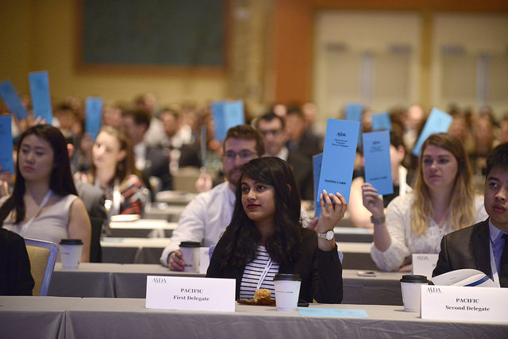
Role of the House of Delegates
Supreme legislative body of ASDA
Elects officers (Executive Committee)
Determines the policies governing ASDA
Amends Bylaws and Standing Rules of the House of Delegates
Notes:
8

Slide 9
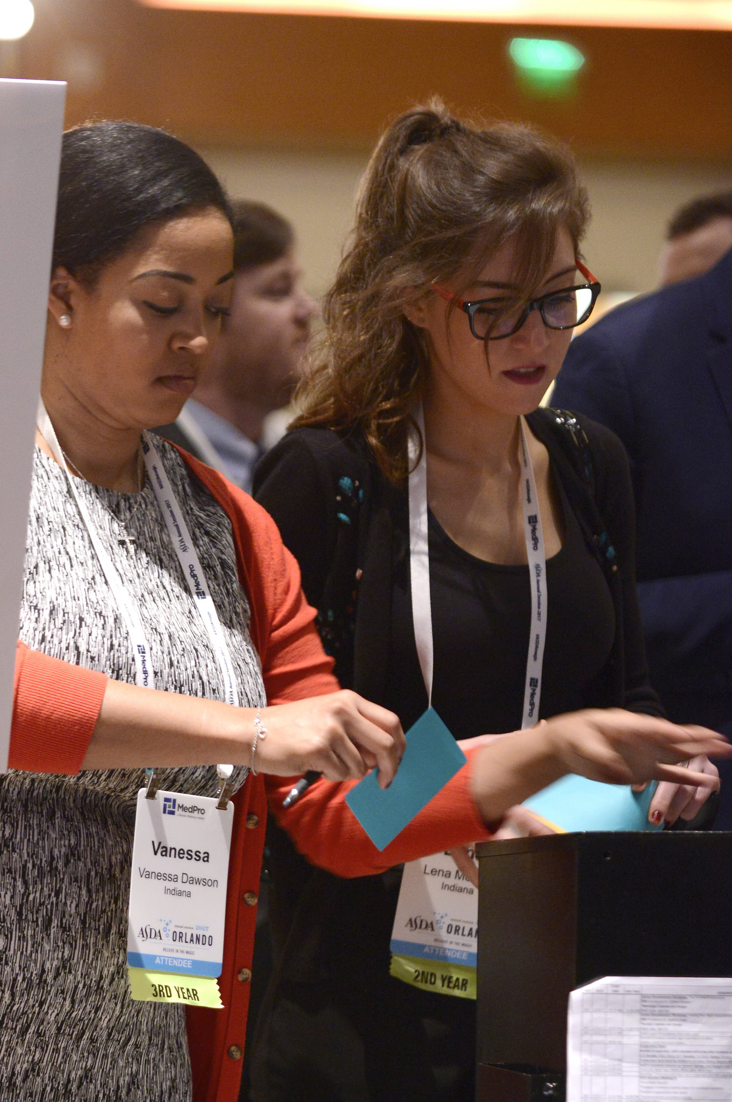
Elections at Annual Session
House of delegates votes on the Executive Committee
Districts elect their trustees
Notes:
9

Slide 10
Standing Committees
Undertake long-term assignments and carry out the work of the house of delegates and Board of Trustees.
Members are appointed by the Board of Trustees.
ASDA currently has the following standing committees:
  Council on Advocacy
  Council on Communications
  Council on Membership
  Council on Professional Issues
  Council on Wellness
  Editorial Board
Notes:
10

Slide 11
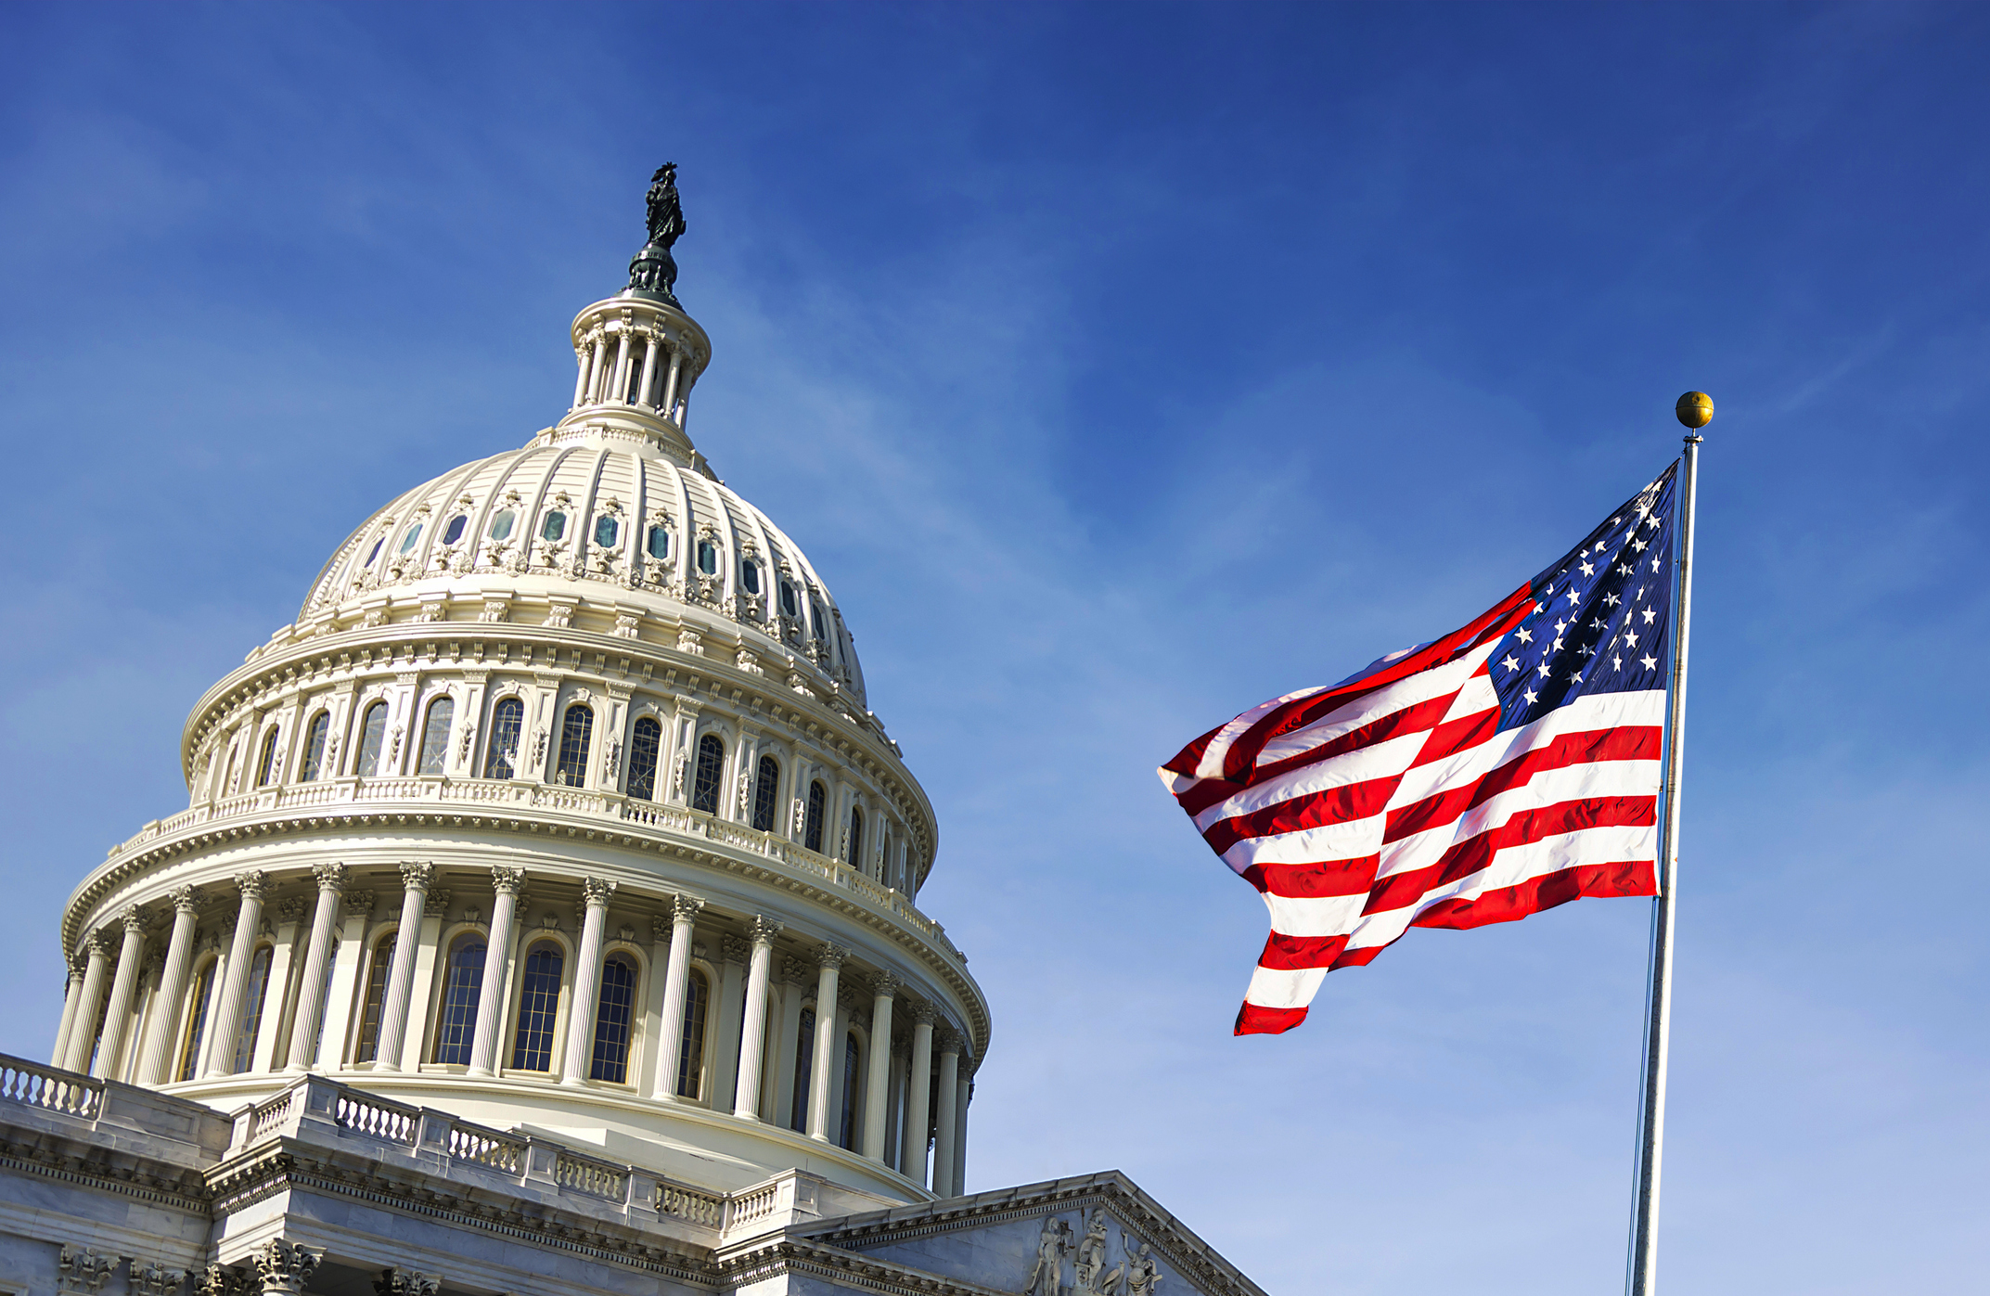
Council on Advocacy
Members include:
  Chair
  Five Legislative Coordinators based on region
  One Executive Committee member
  Two Board of Trustees liaisons
Represents the interests of dental students on legislative and regulatory issues that impact the dental profession. The council launches grassroots initiatives to promote action-oriented advocacy in support of dental students and the patients they serve.

Slide 12

Council on Communications
Members include:
  Chair
  Two associates
  Two video production managers
  Two Board of Trustees liaisons
The Council on Communications is responsible for creating various forms of content to disseminate information via ASDA’s Instagram page to promote national ASDA initiatives. The council acts as a resource for and promotes chapter, district and national ASDA communication efforts.

Slide 13

Council on Membership
Members include:
  Chair
  Two associates
  One AS/IDP associate
  Two Board of Trustees liaisons
The Council on Membership provides a member voice in the development of resources that meet the needs of members, leaders and chapters. The council awards chapter recognition programs including the Gold Crown Awards.

Slide 14

Council on Professional Issues
Members include:
  Chair
  Two associates
  Two Board of Trustees liaisons
  Immediate Past President
The Council on Professional Issues serves the association as a resource on community engagement, dental outreach and other pandemic/epidemic implications that may arise. Additionally, the council is committed to promoting diversity, equity, and inclusion initiatives among dental students.

Slide 15

Editorial Board
Members include:
  Editor-in-Chief
  Six contributing editors
The Editorial Board works closely with staff to determine the strategy and themes for ASDA’s magazine, Contour. Editorial Board members develop the content for Contour.
Notes:
15

Slide 16
Management Committees
The Board of Trustees may appoint management committees to address initiatives that fall outside the duties of the Board but require Board knowledge or expertise.
Appointed by the Executive Committee.
ASDA currently has two management committees:
  Governance Committee
  Committee on Sessions

Slide 17

Committee on Sessions
Members include:
Chair
Two Board of Trustees liaisons
  The Committee on Sessions is responsible for identifying opportunities for member engagement at the upcoming Annual Session, including education opportunities and select supplemental member activities. The committee also vets the meeting theme. The committee maintains the importance of governance and policy associated with the Annual Session.

Slide 18

Governance Committee
  Members include:
  Chair
  Speaker of the House
  Three Board of Trustees liaisons
The Governance Committee reviews the ASDA governance documents and proposes changes, if needed, to keep documents current. The committee ensures that all ASDA documents are consistent with the governing documents. The committee is responsible for the ongoing assessment of the Board of Trustees composition and election process in conjunction with the development and evaluation of the association’s strategic plan.

Slide 19
ASDA staff
Manage the day-to-day operations
Serve members and support leaders
Serve as liaisons to standing committees and board management committees

